Slide 1
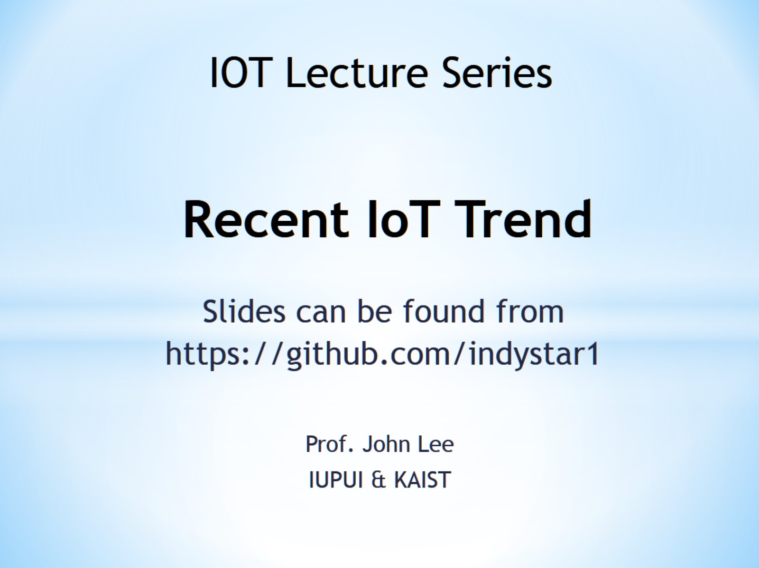
Recent IoT Trend

Slide 2
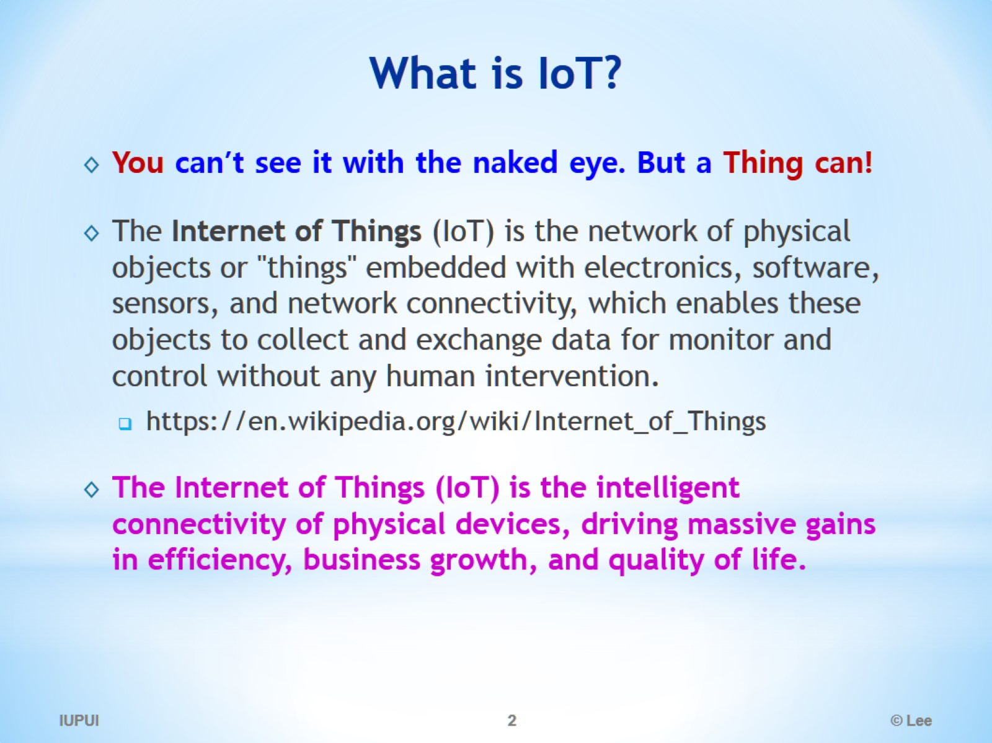
What is IoT?

Slide 3
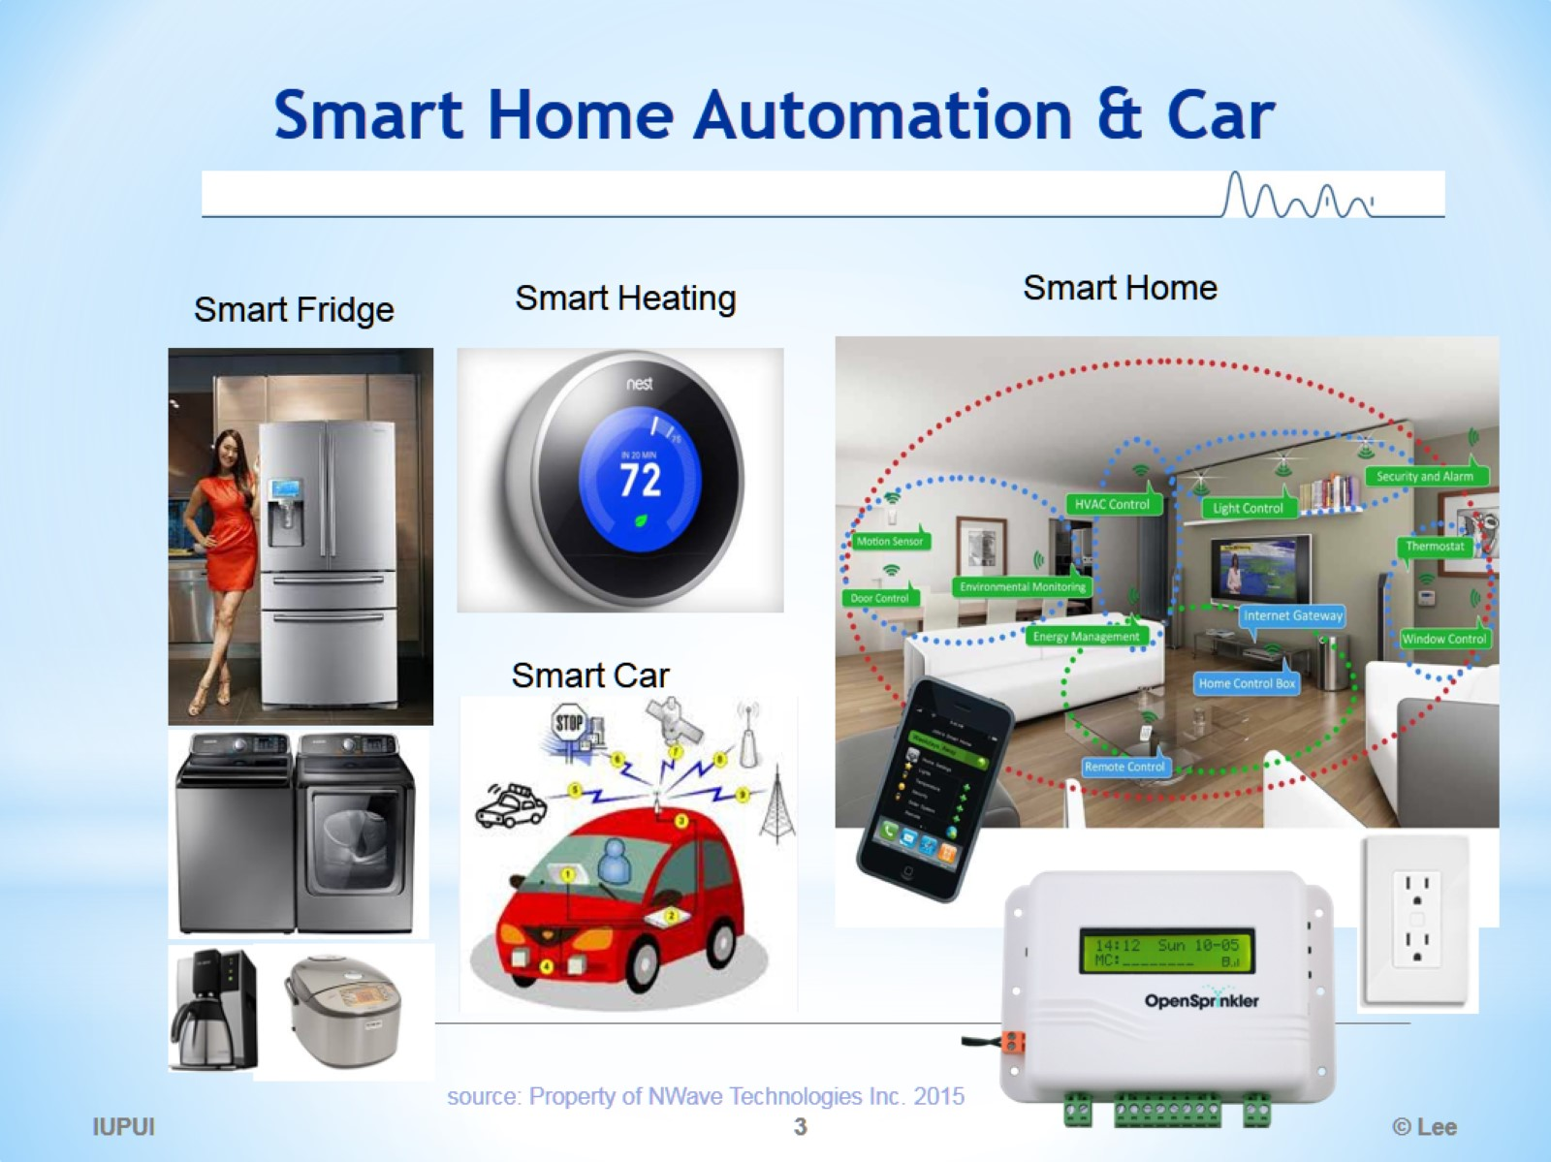
Smart Home Automation & Car

Slide 4
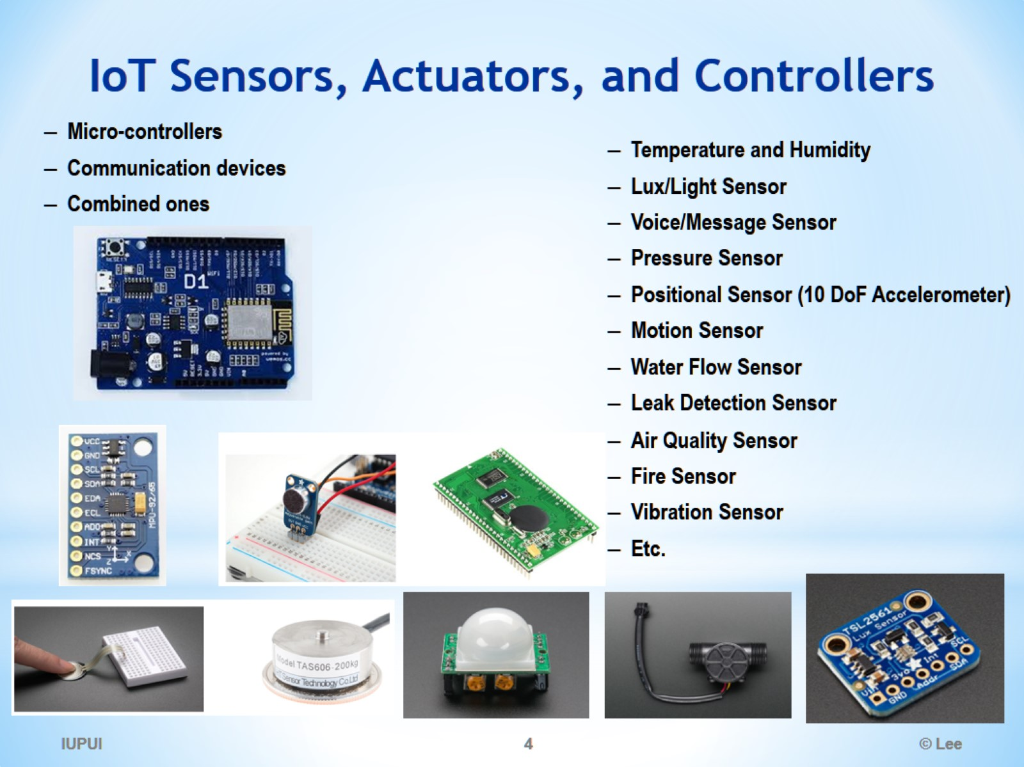
IoT Sensors, Actuators, and Controllers

Slide 5
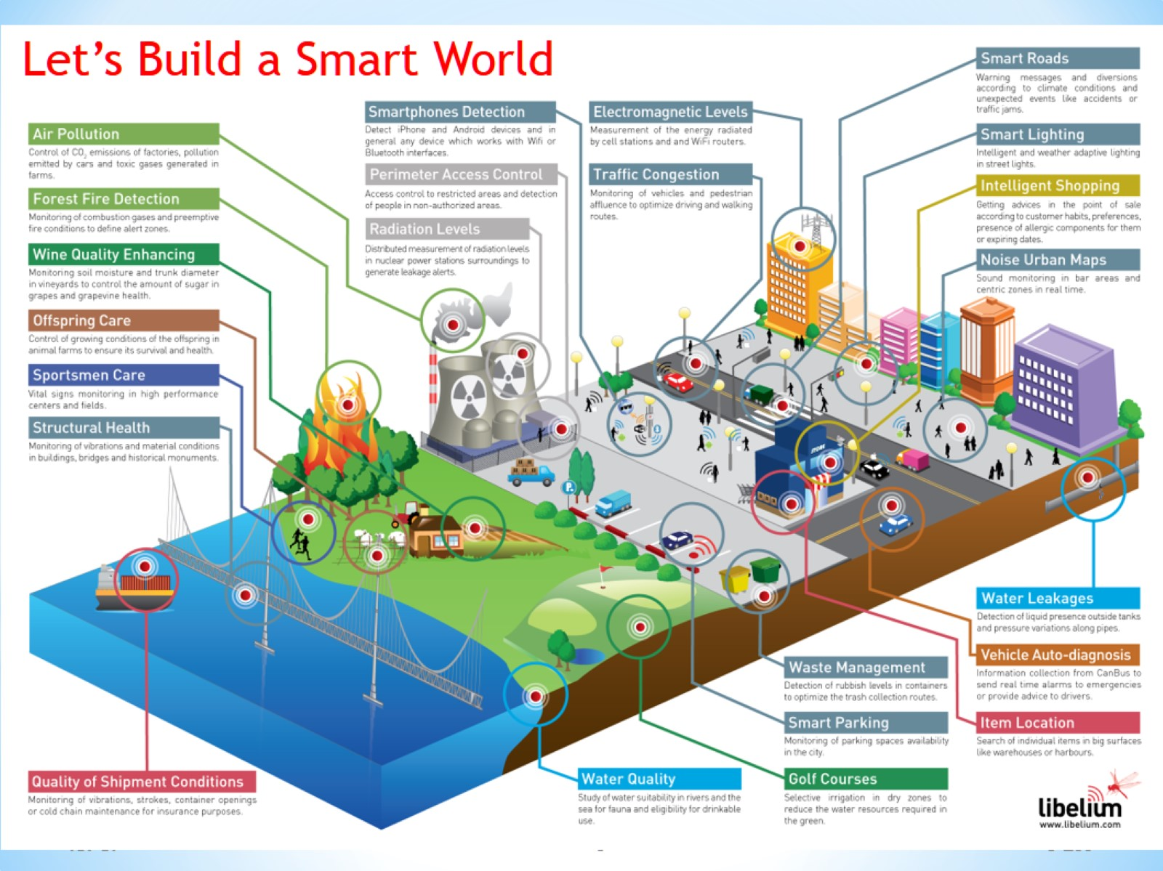

Slide 6
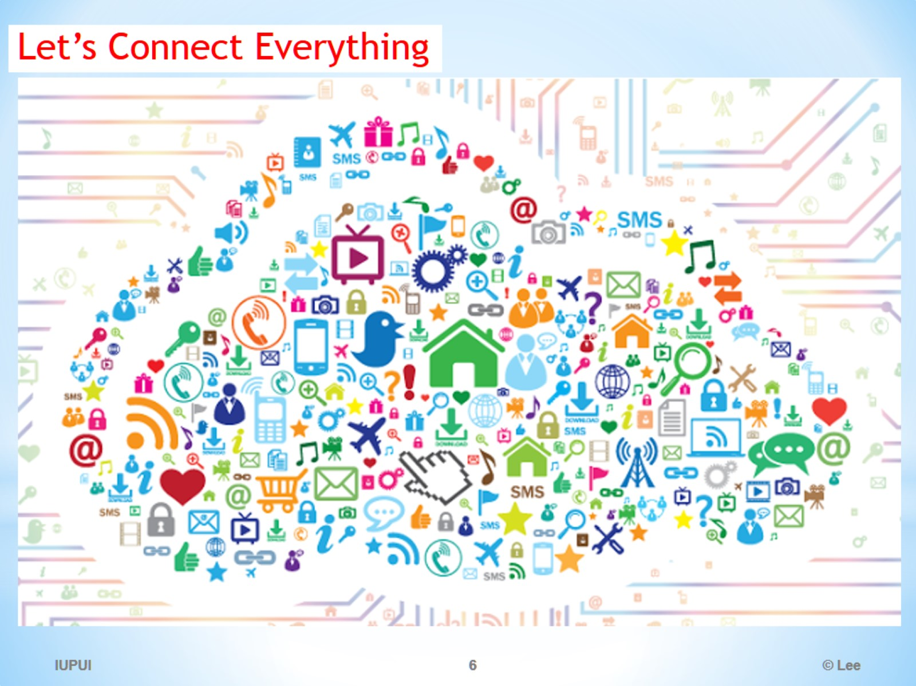

Slide 7
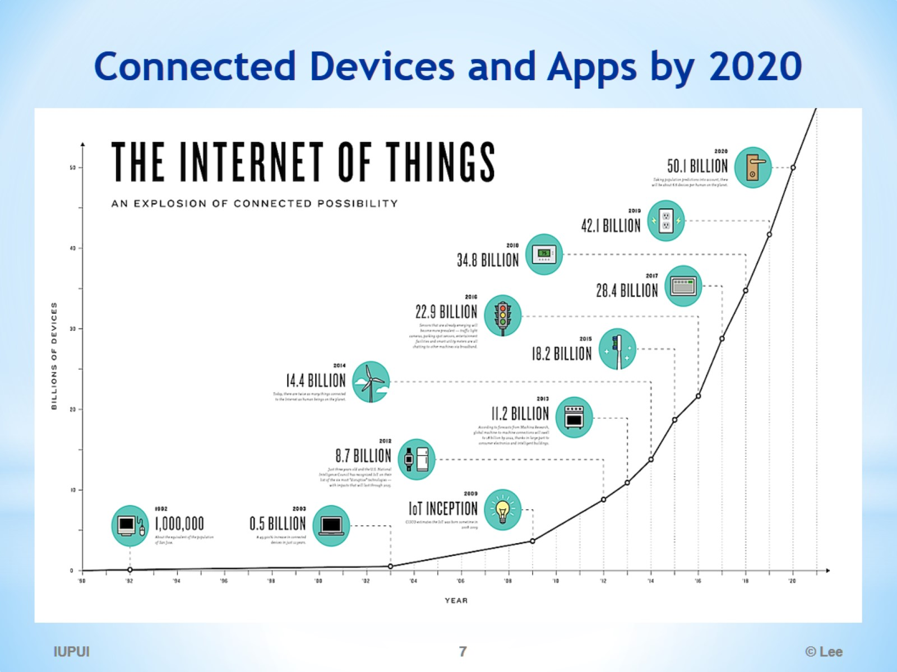
Connected Devices and Apps by 2020

Slide 8
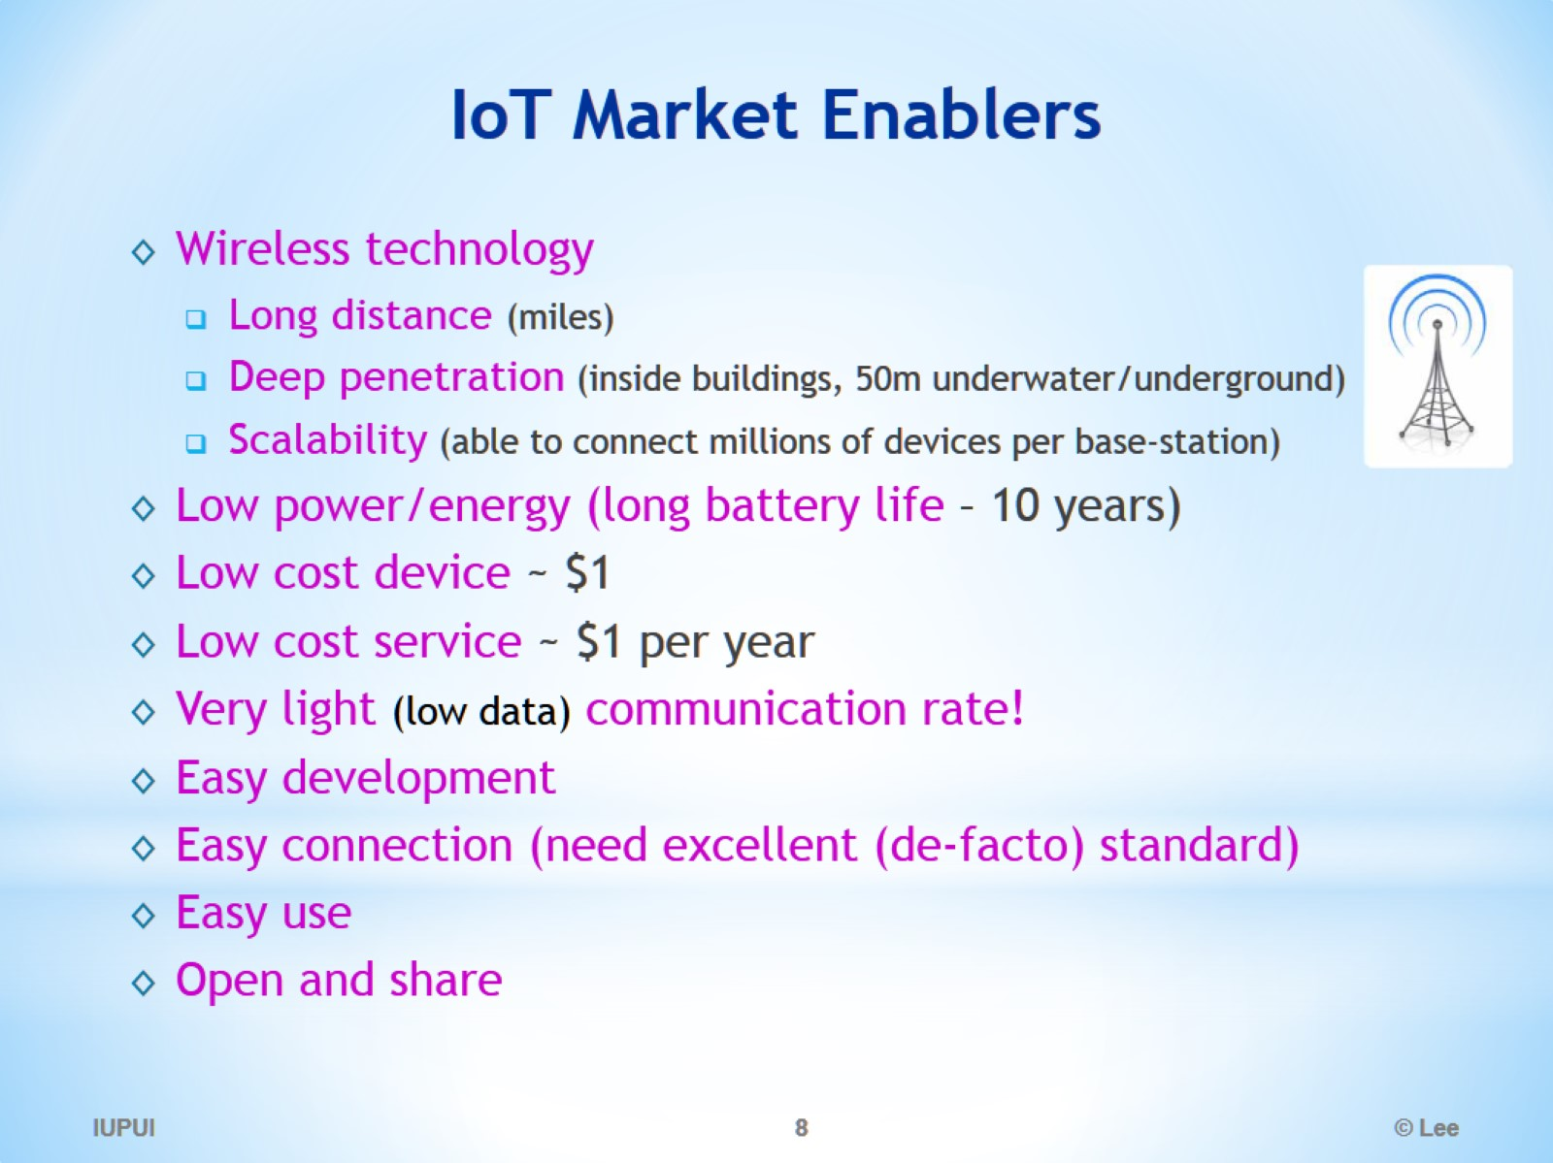
IoT Market Enablers

Slide 9
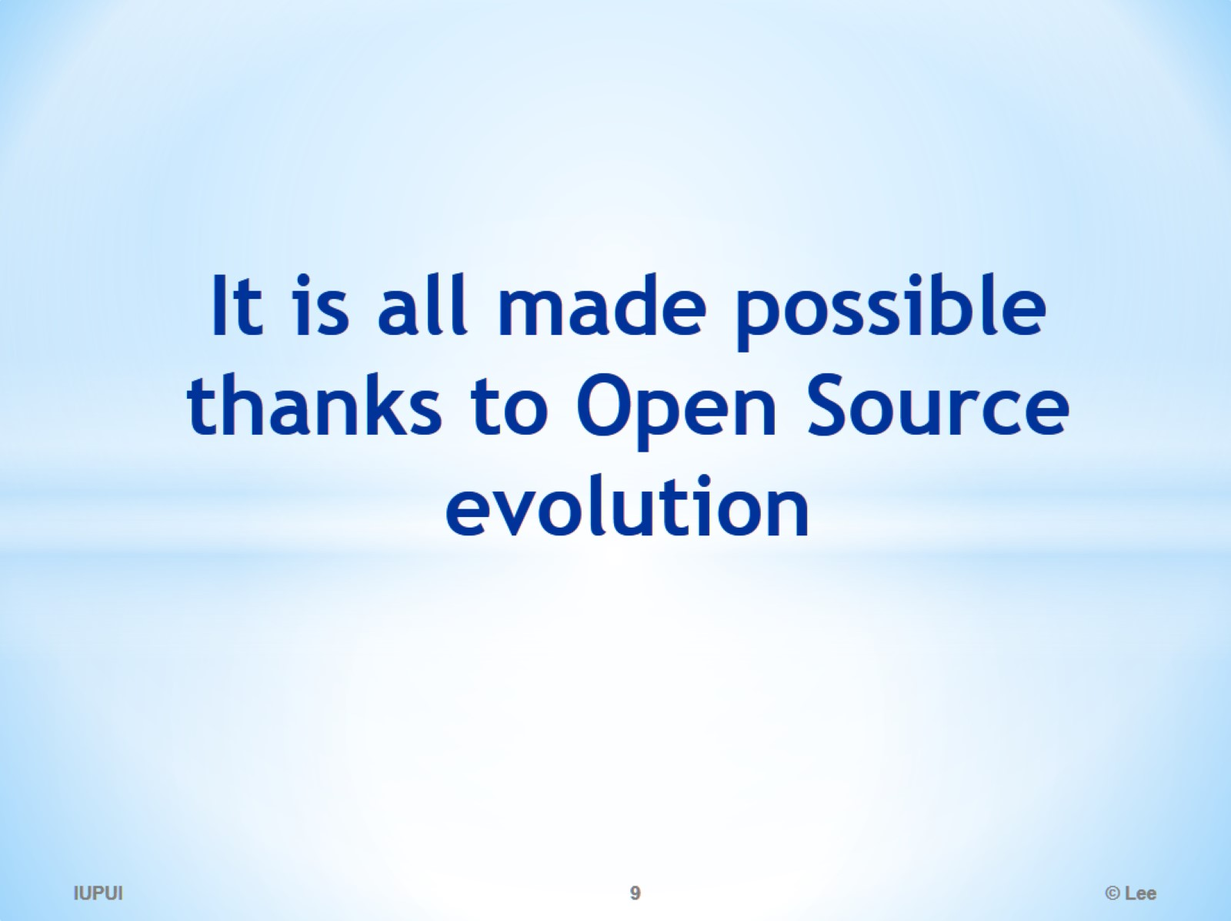
It is all made possible thanks to Open Source evolution

Slide 10
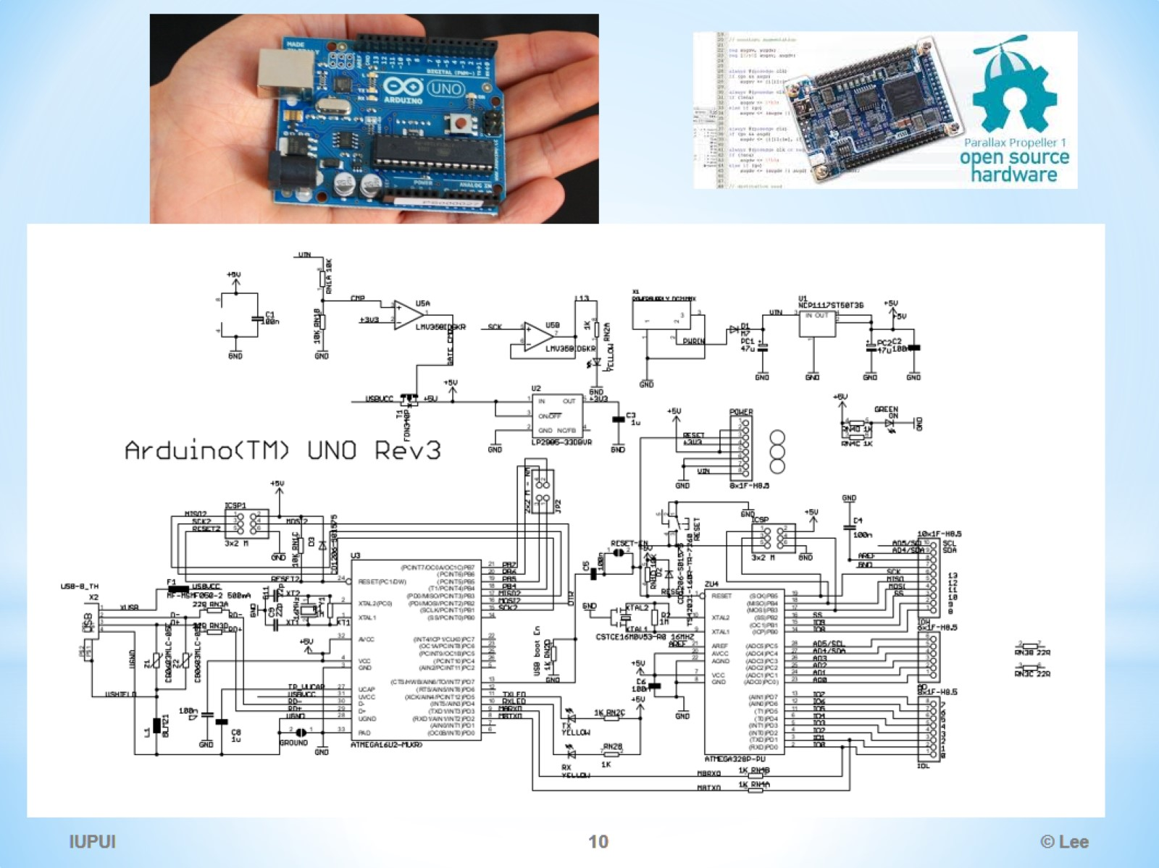

Slide 11
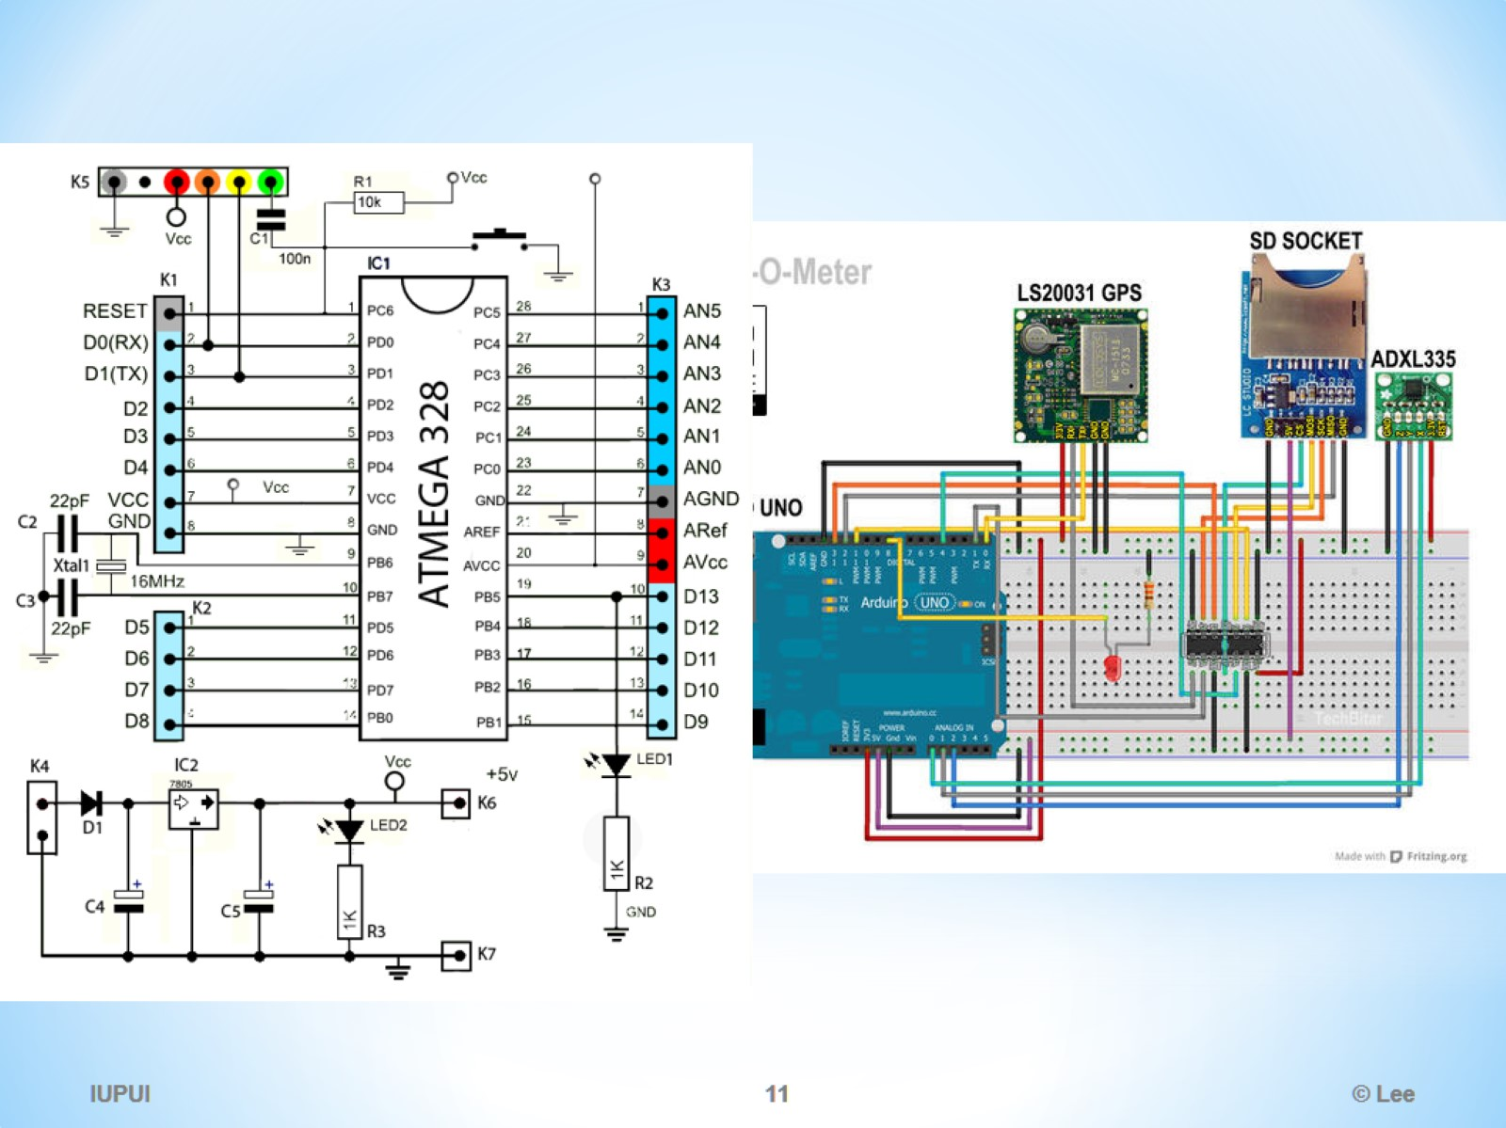

Slide 12
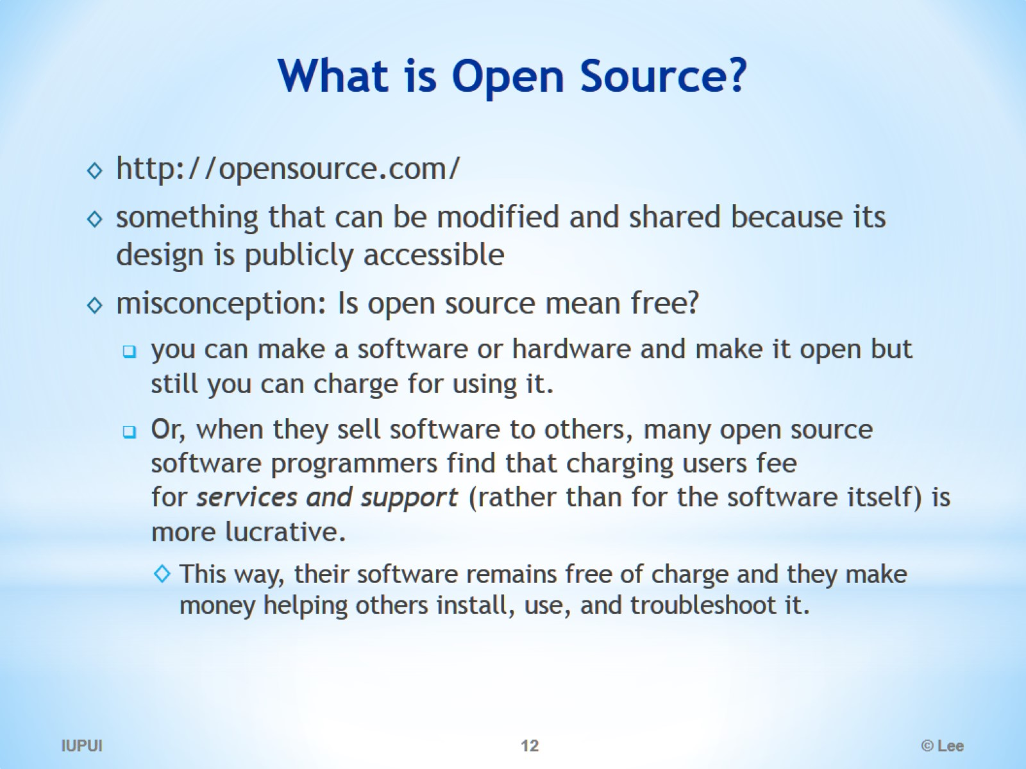
What is Open Source?

Slide 13
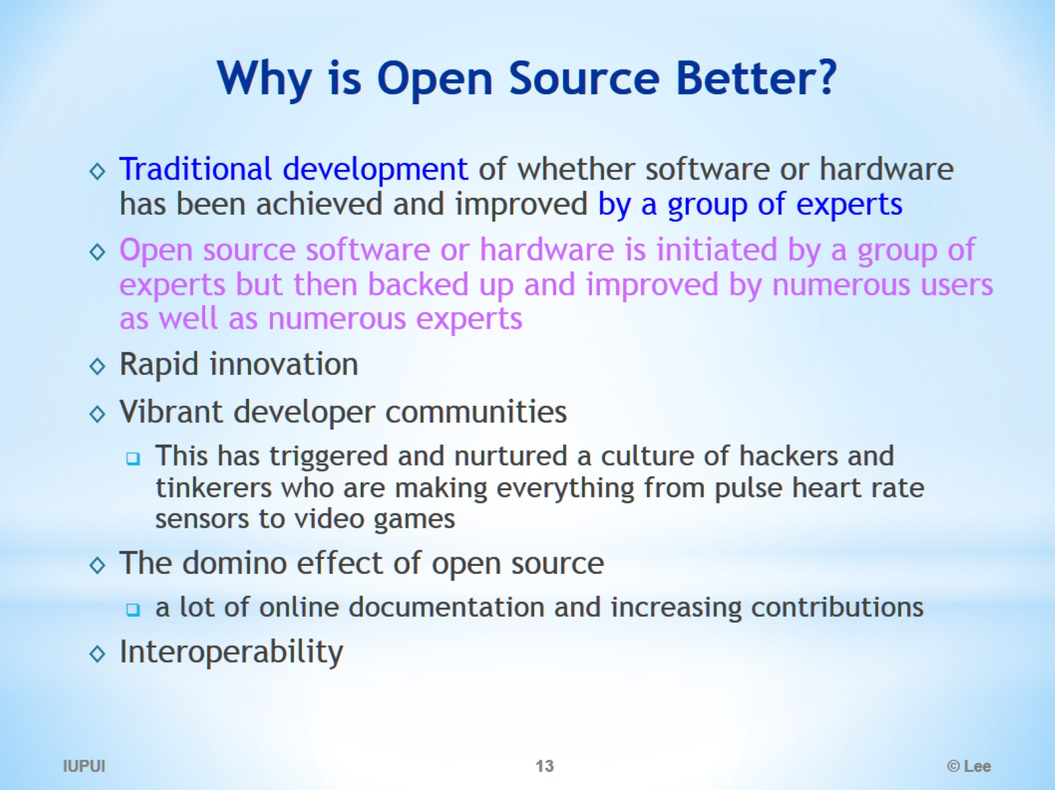
Why is Open Source Better?

Slide 14
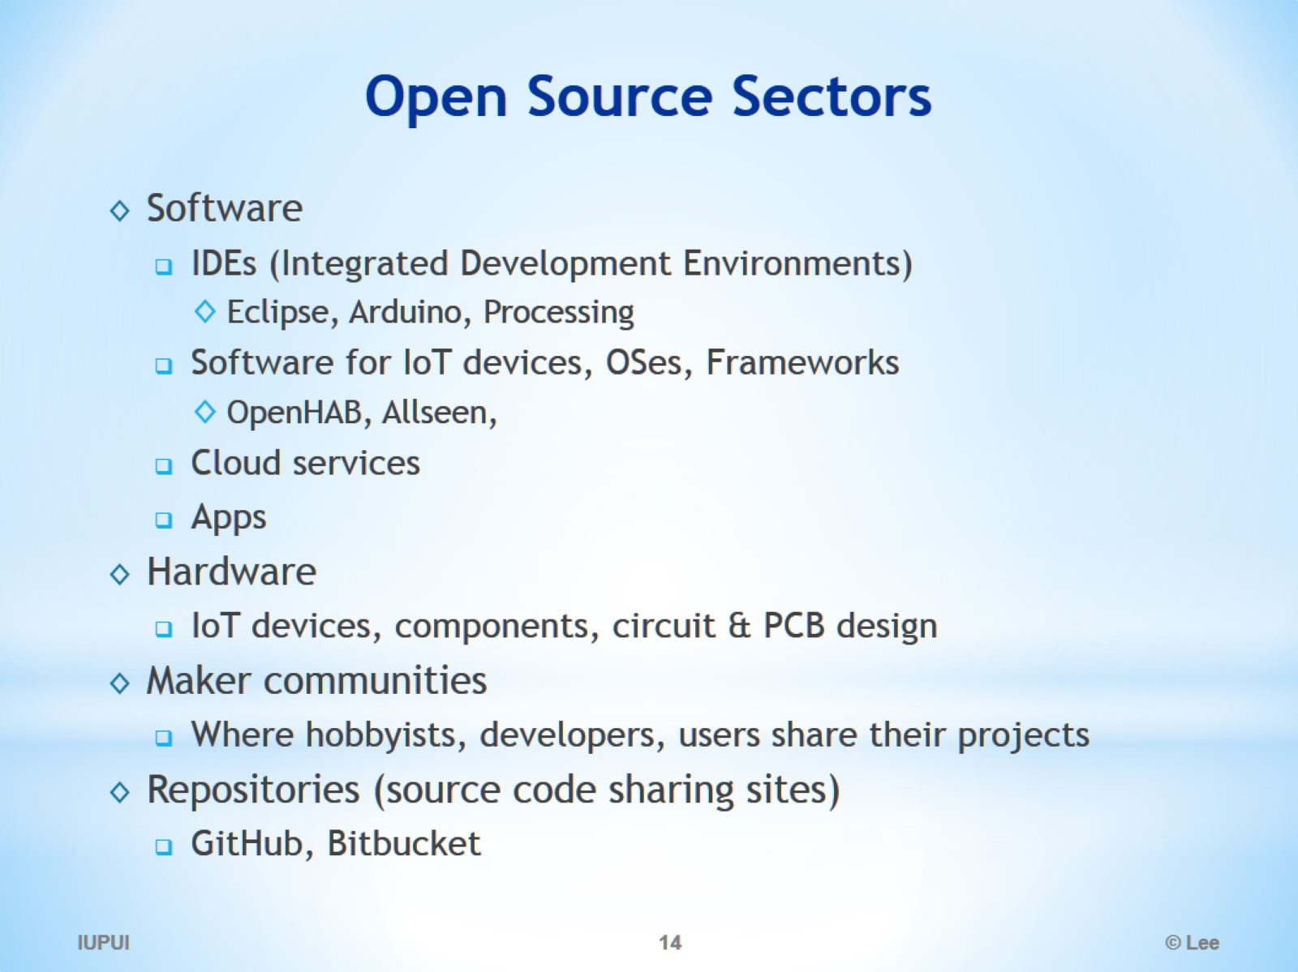
Open Source Sectors

Slide 15
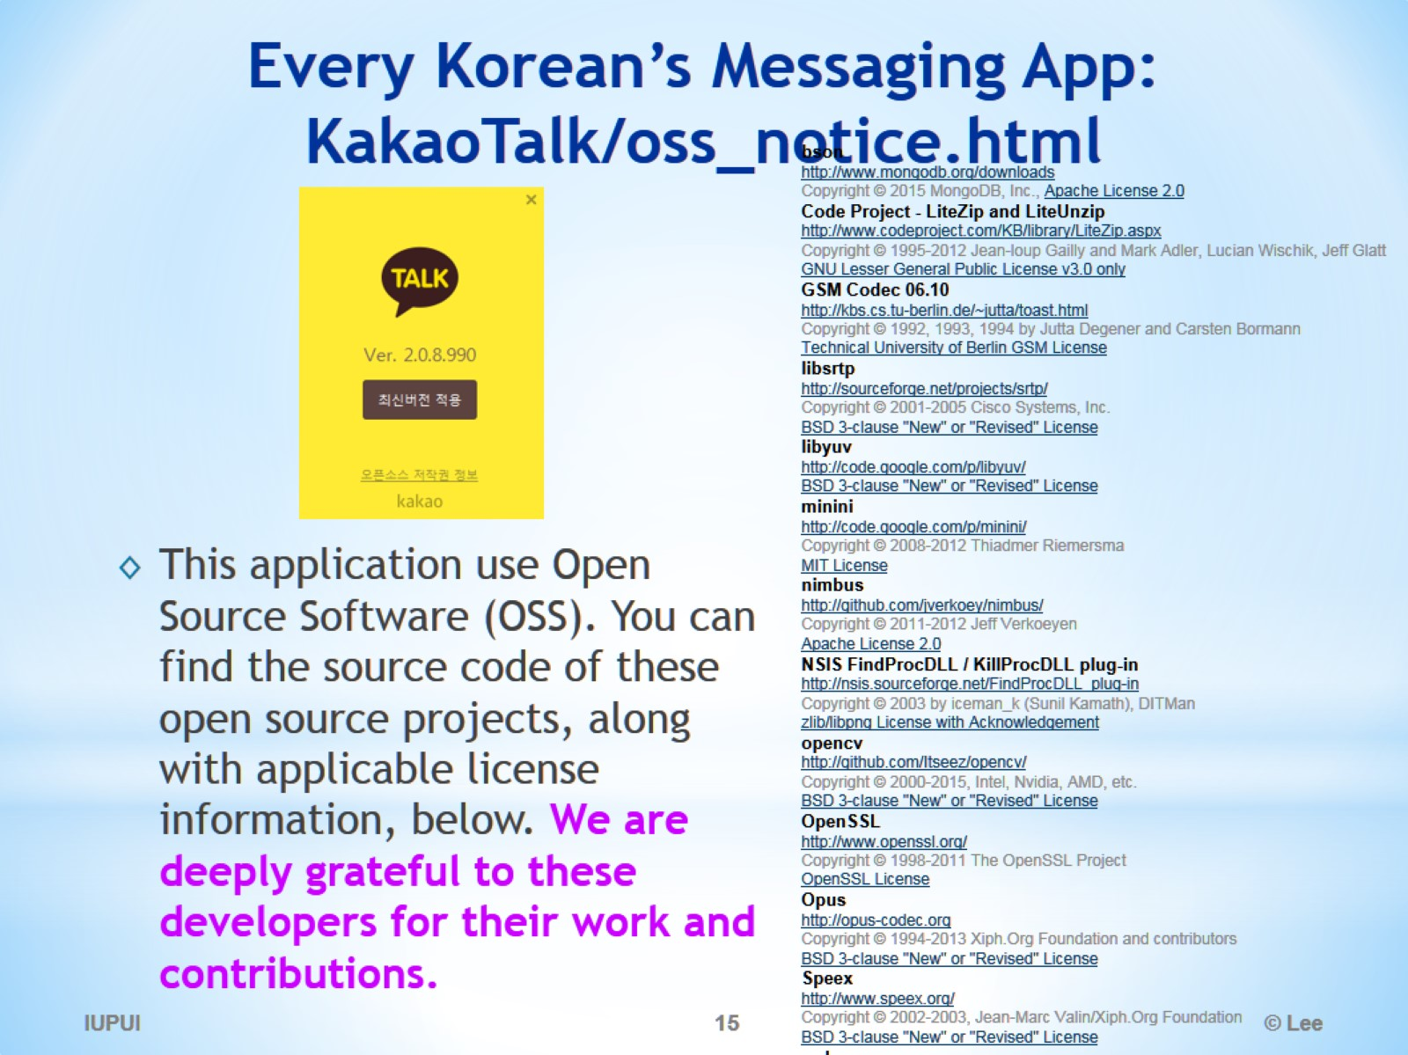
Every Korean’s Messaging App: KakaoTalk/oss_notice.html

Slide 16
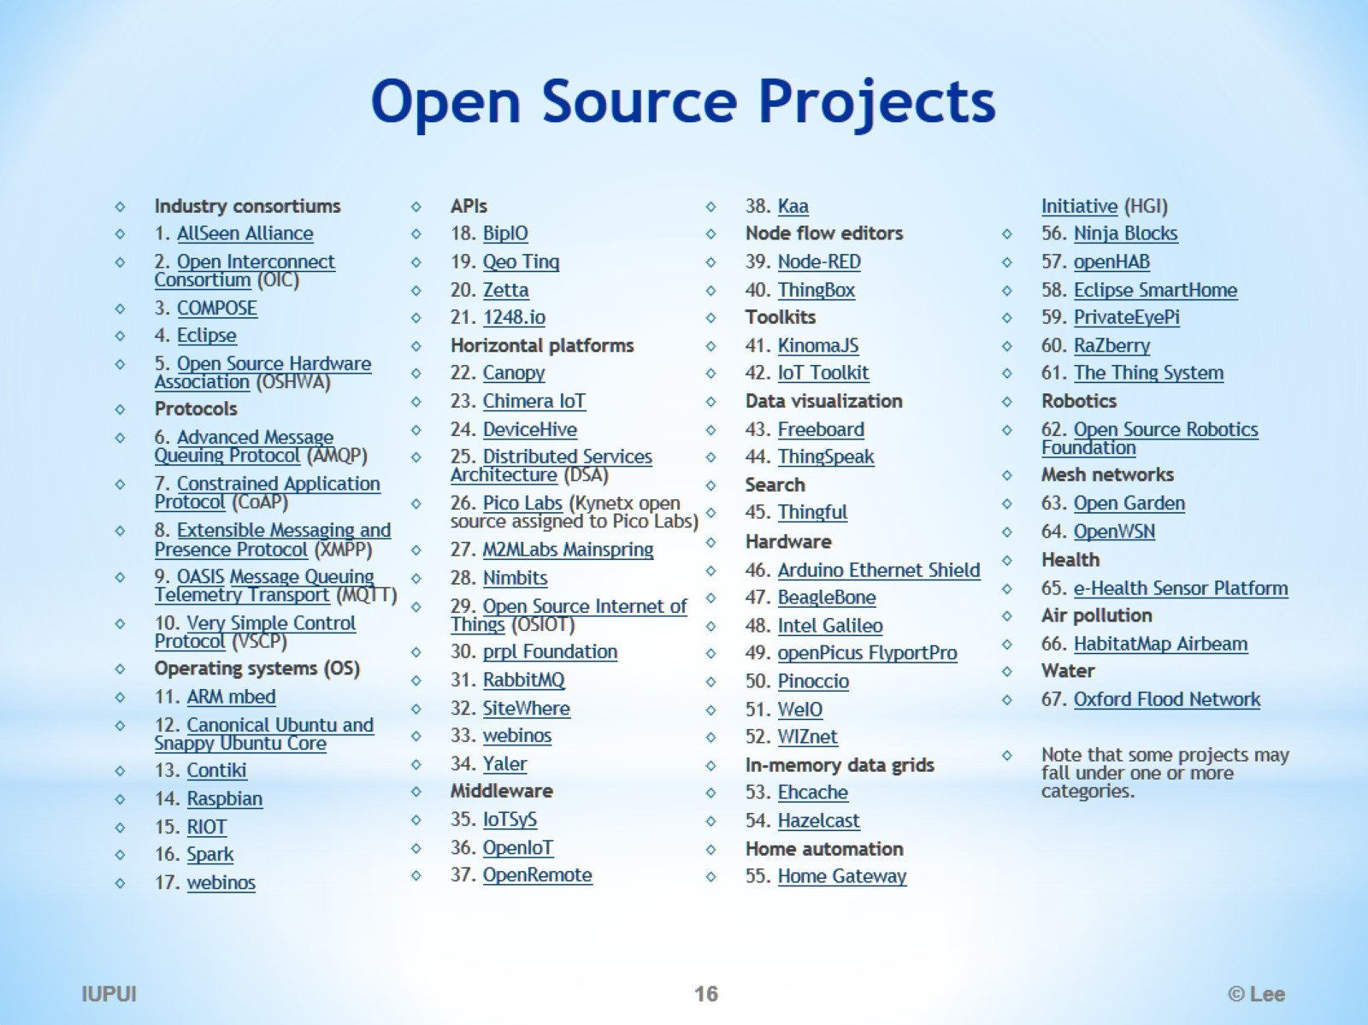
Open Source Projects

Slide 17
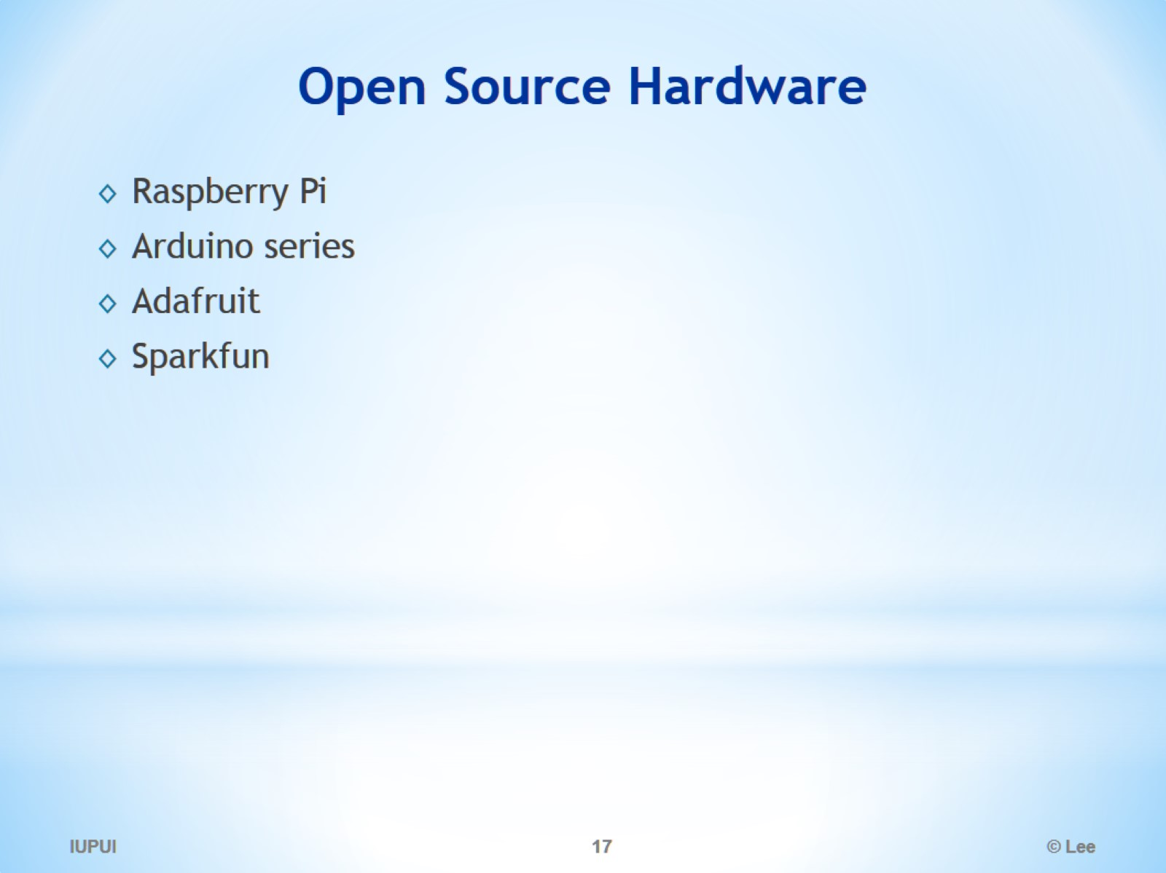
Open Source Hardware

Slide 18
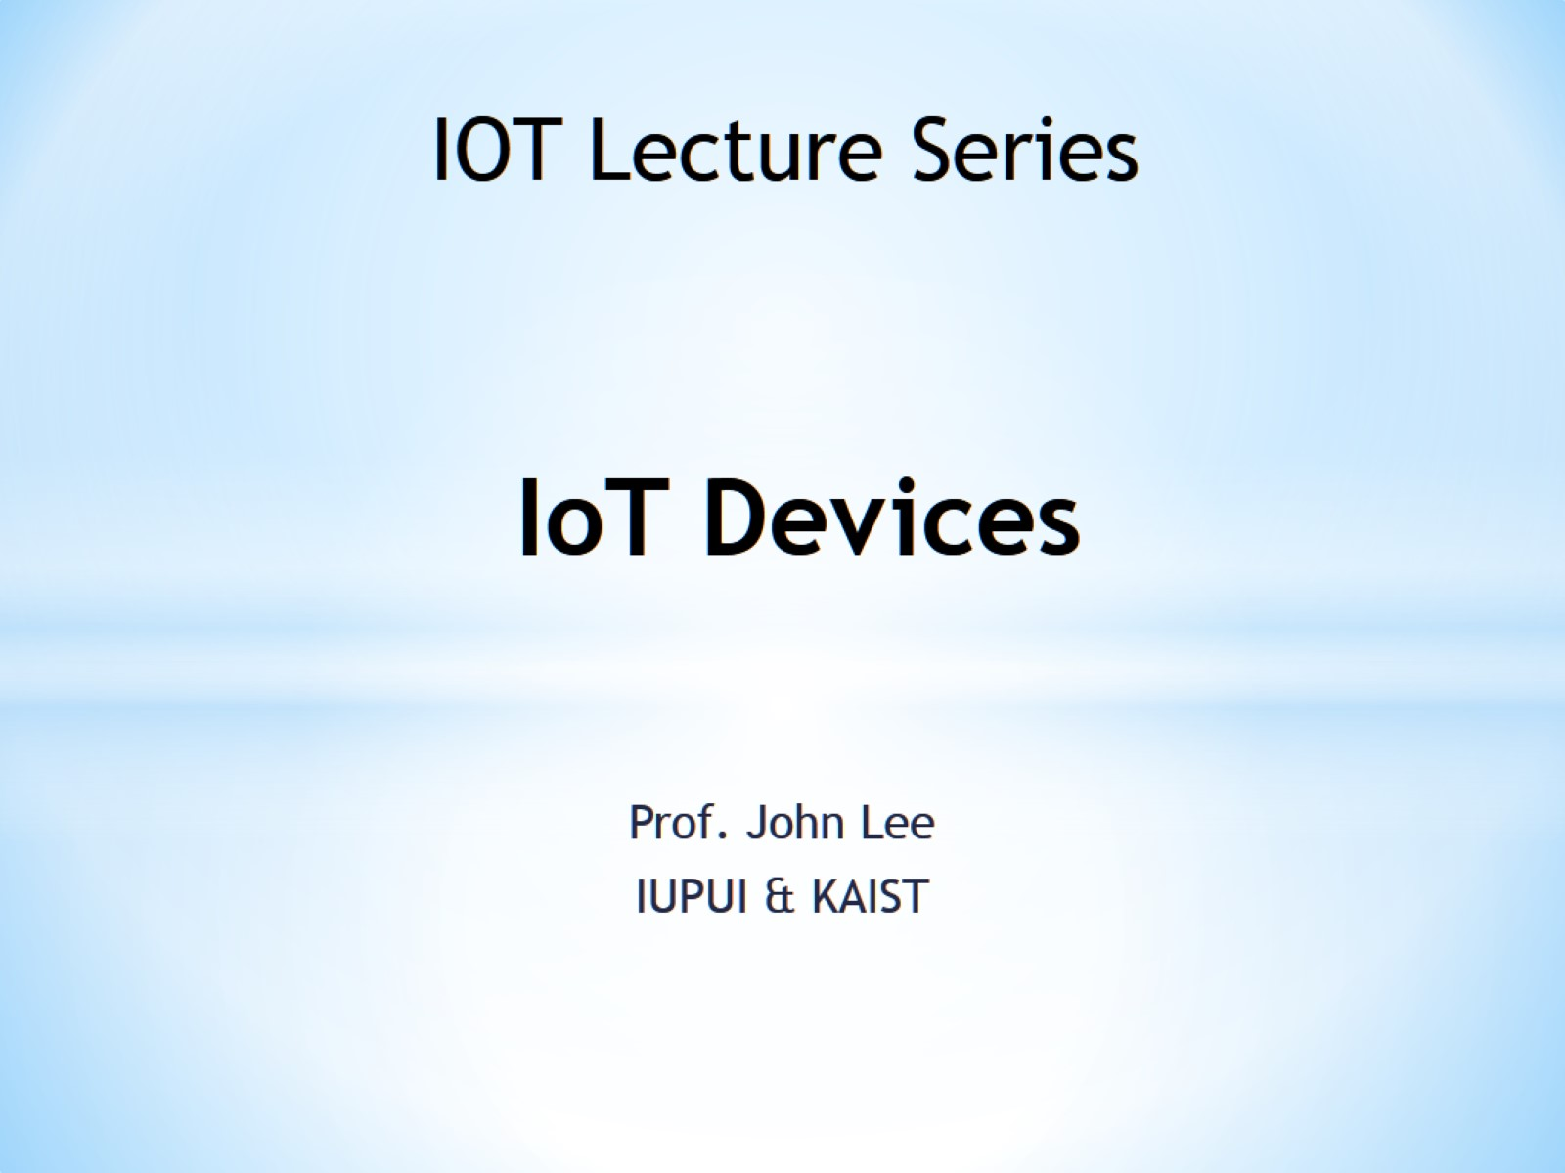
IoT Devices

Slide 19
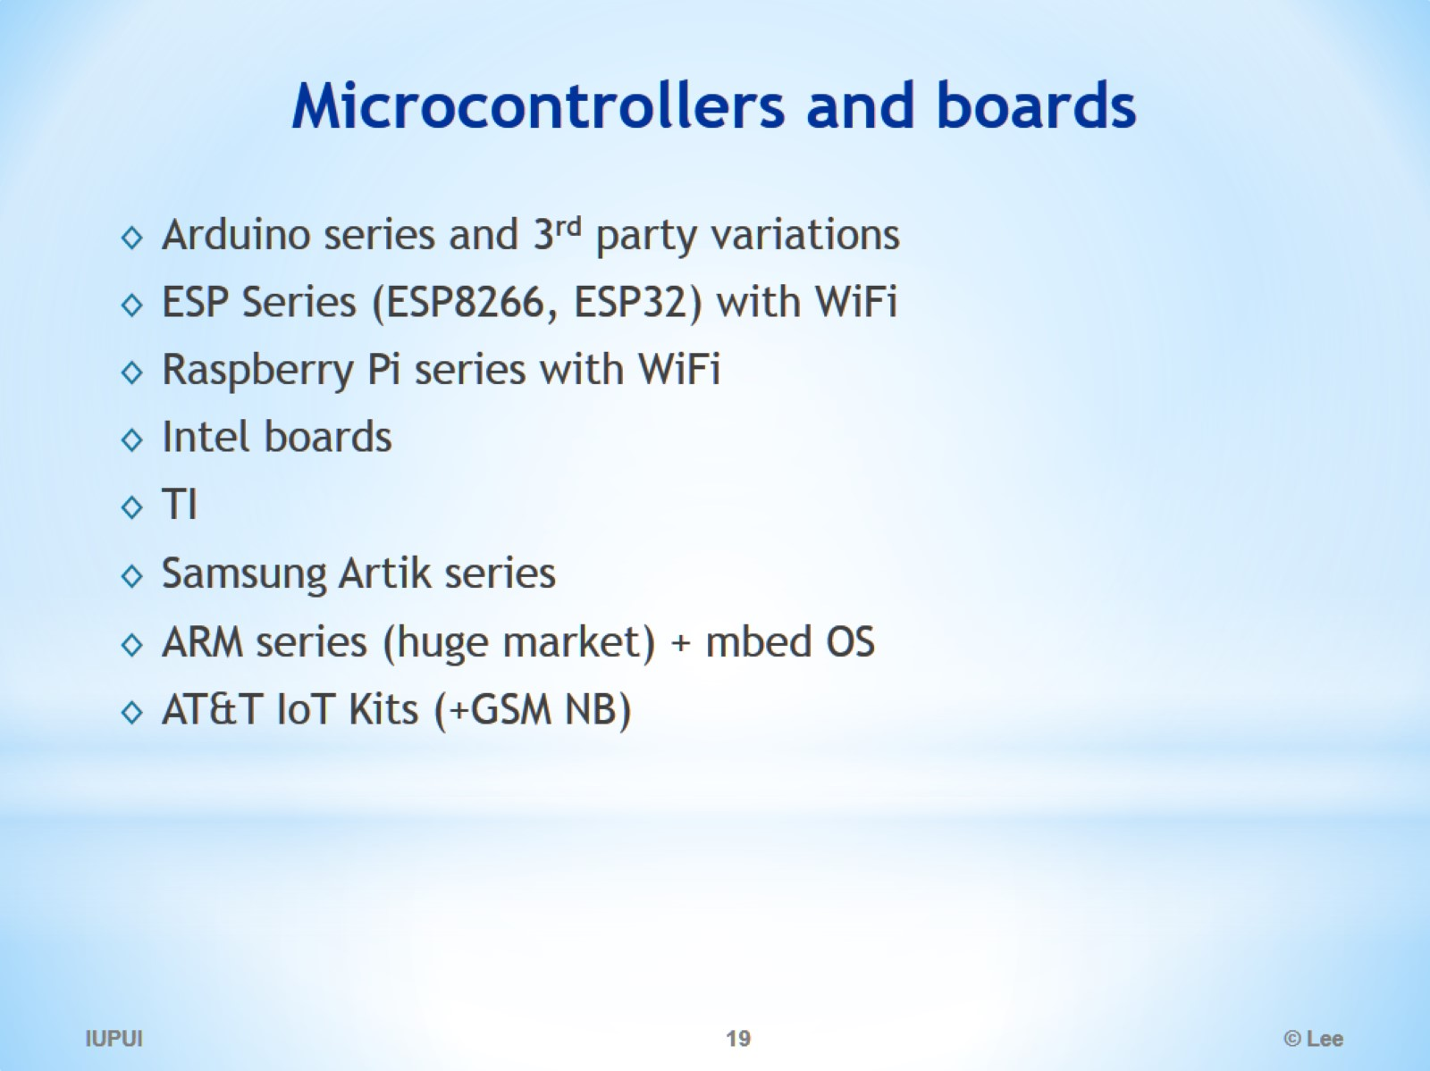
Microcontrollers and boards

Slide 20
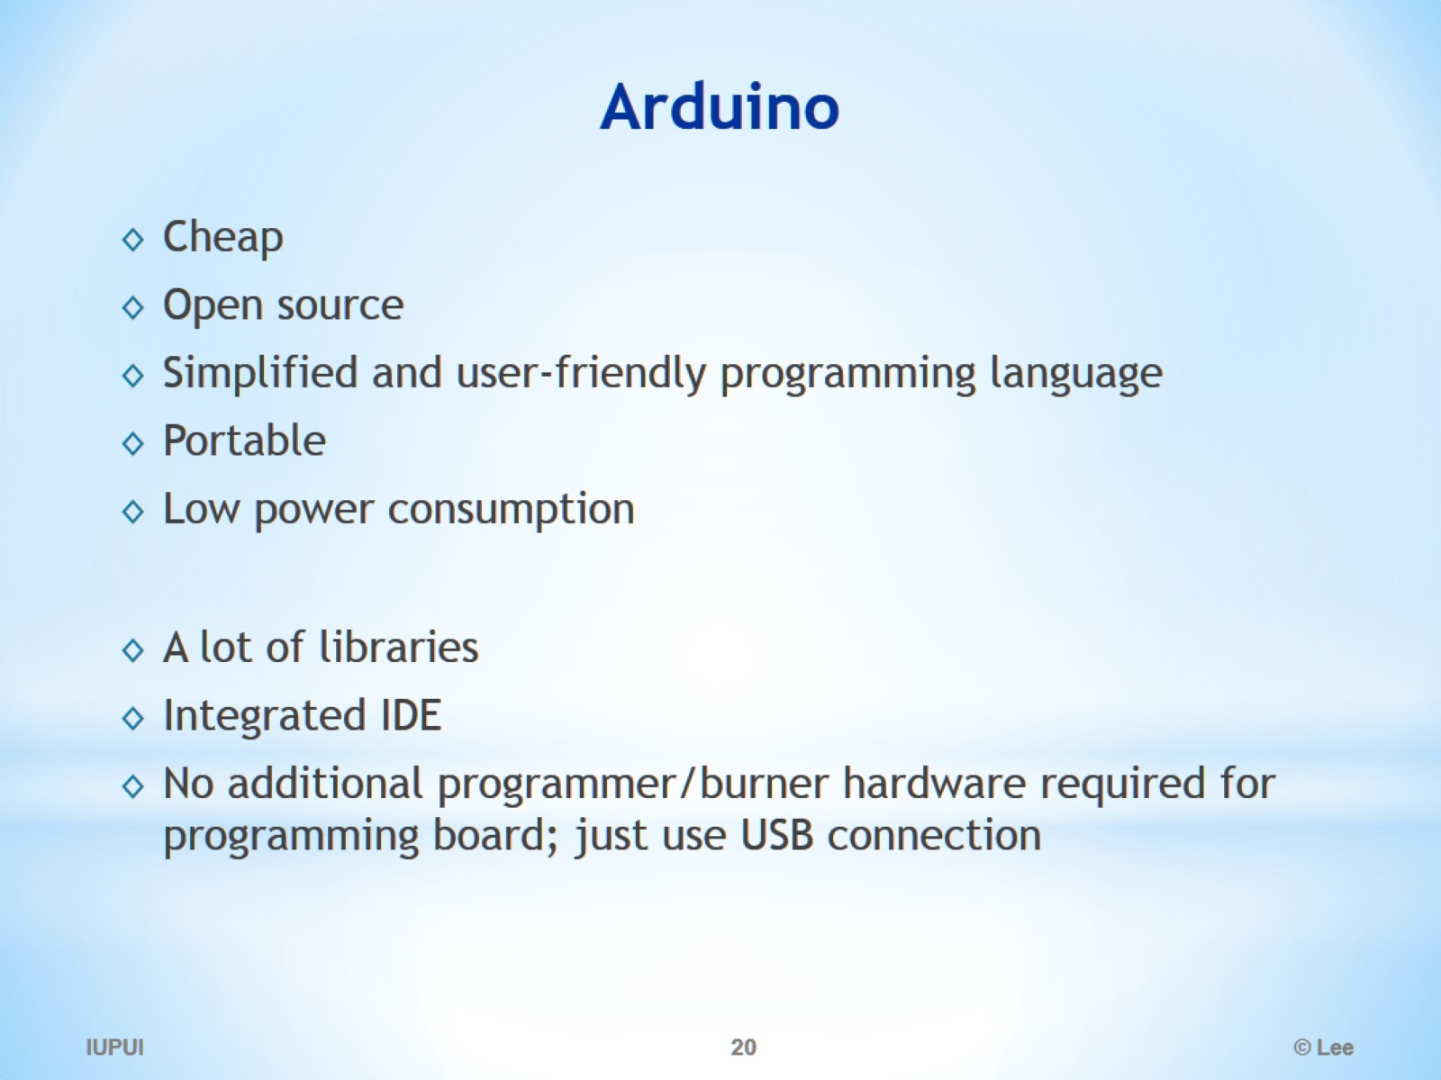
Arduino

Slide 21
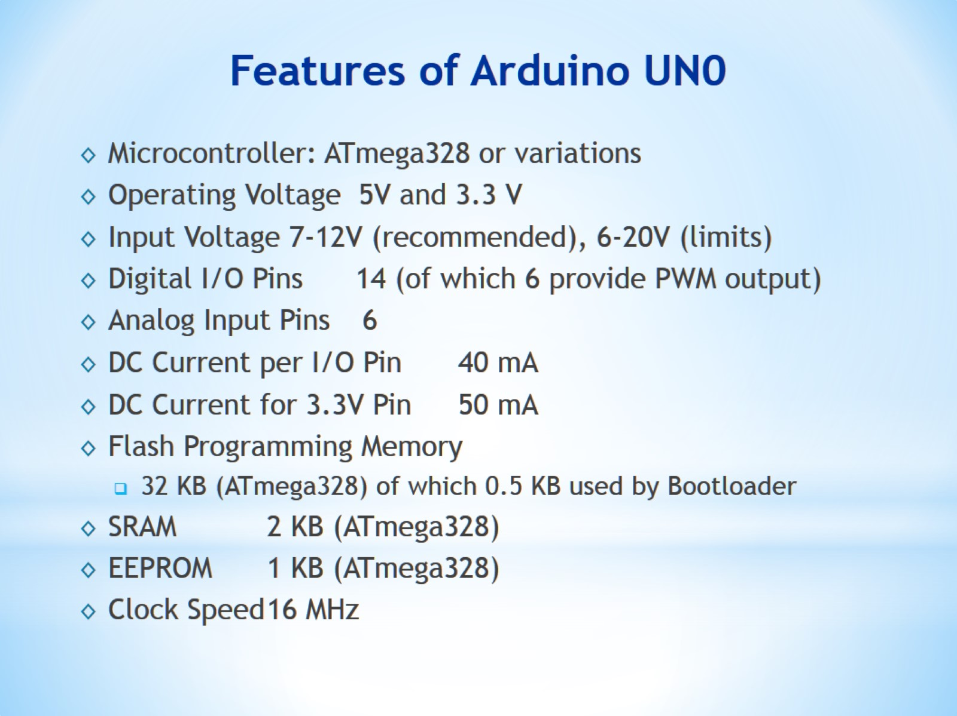
Features of Arduino UN0

Slide 22
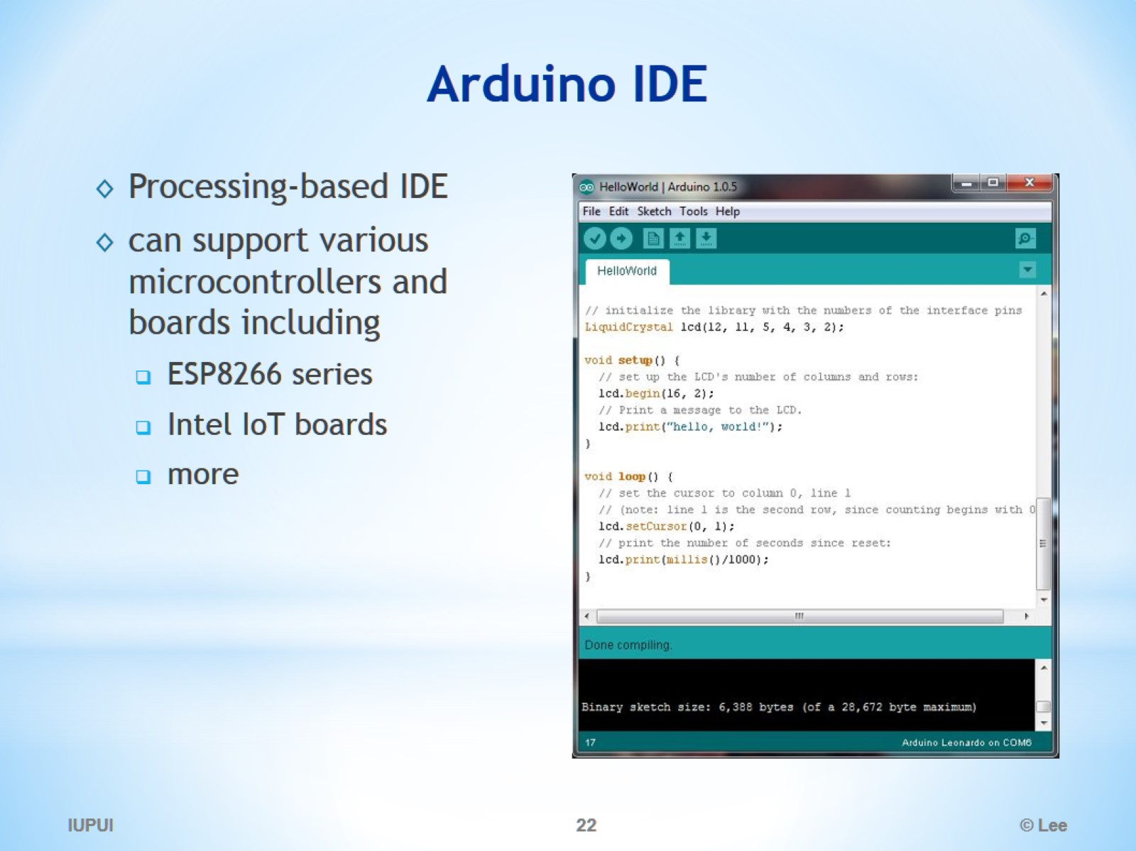
Arduino IDE

Slide 23
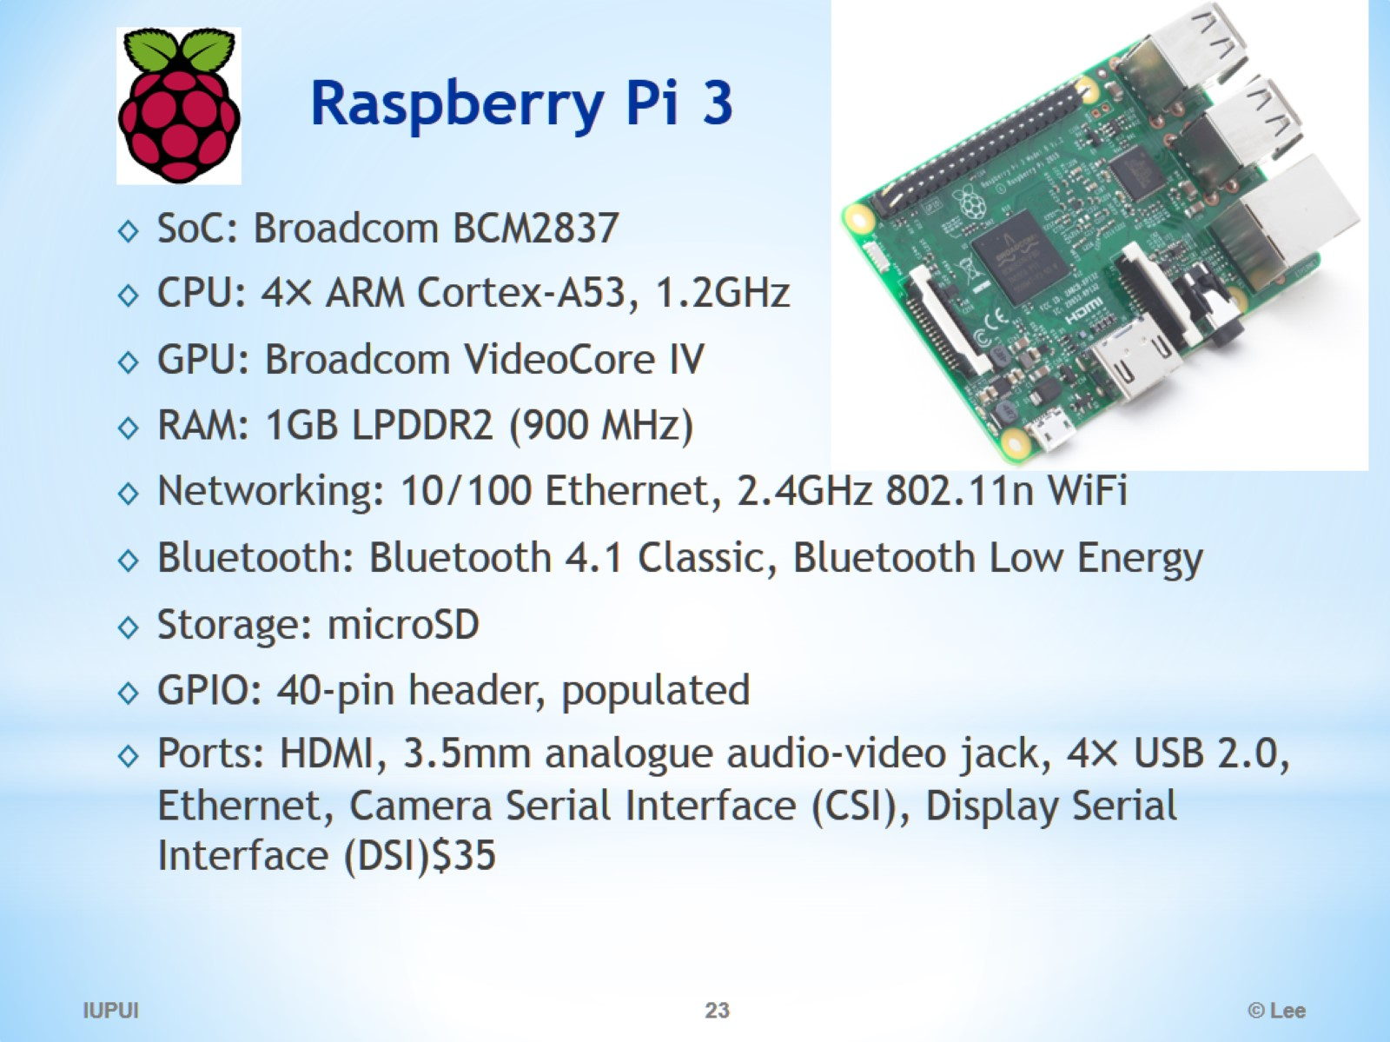
Raspberry Pi 3

Slide 24
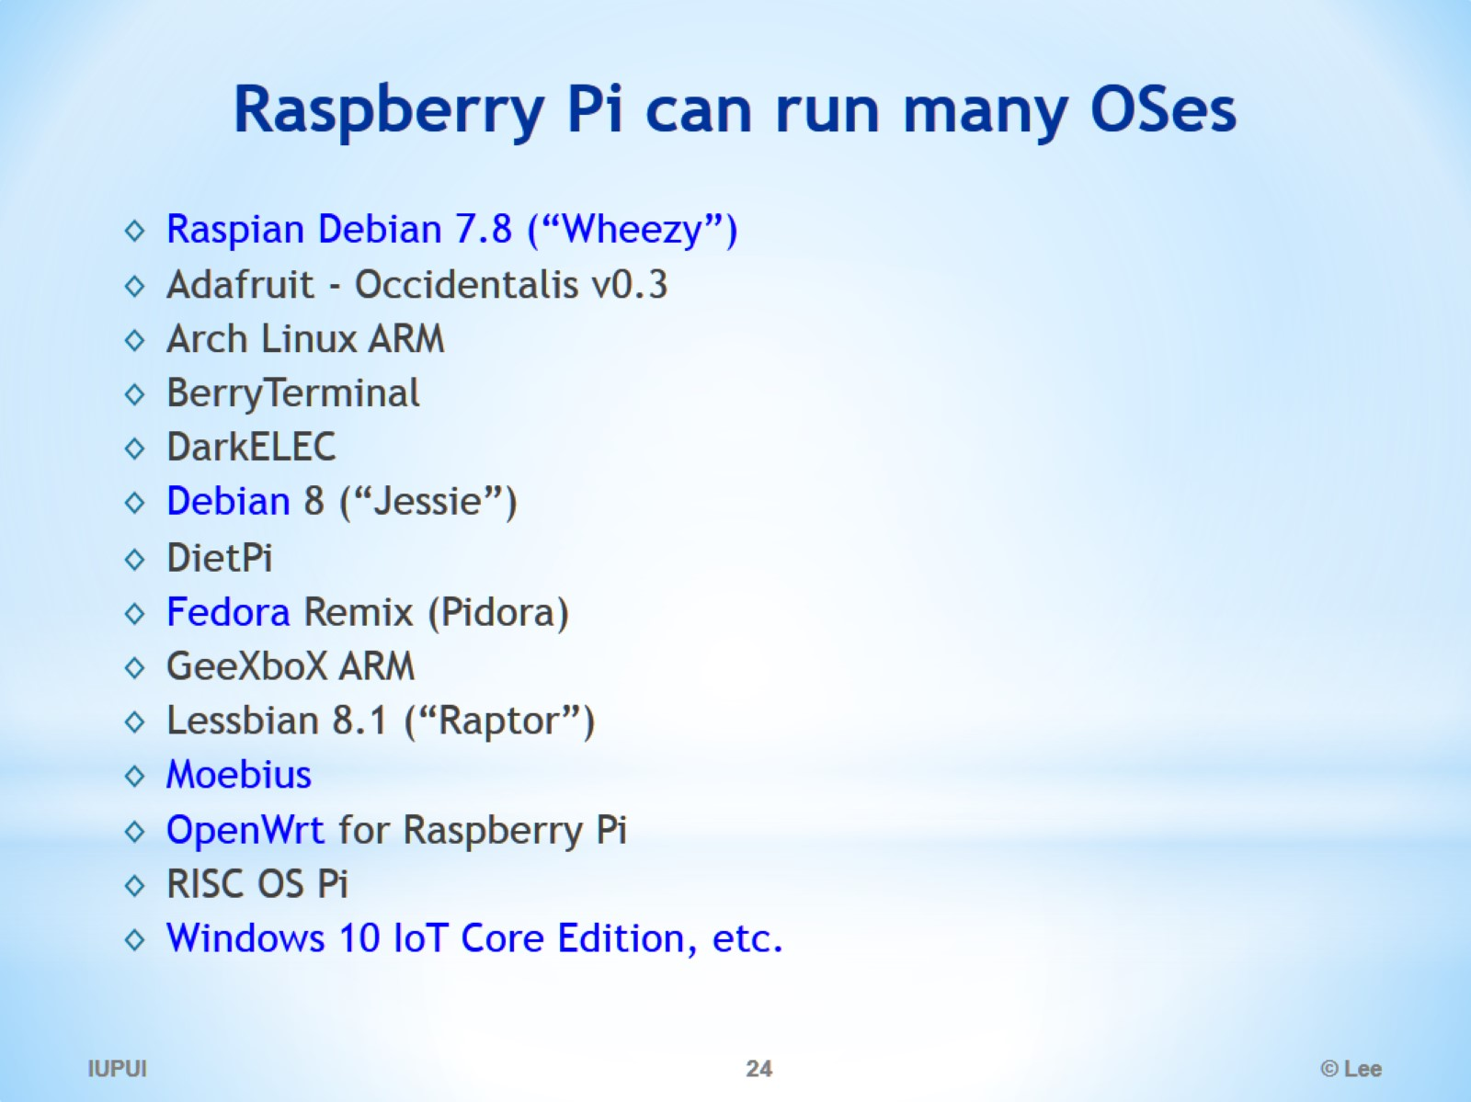
Raspberry Pi can run many OSes

Slide 25
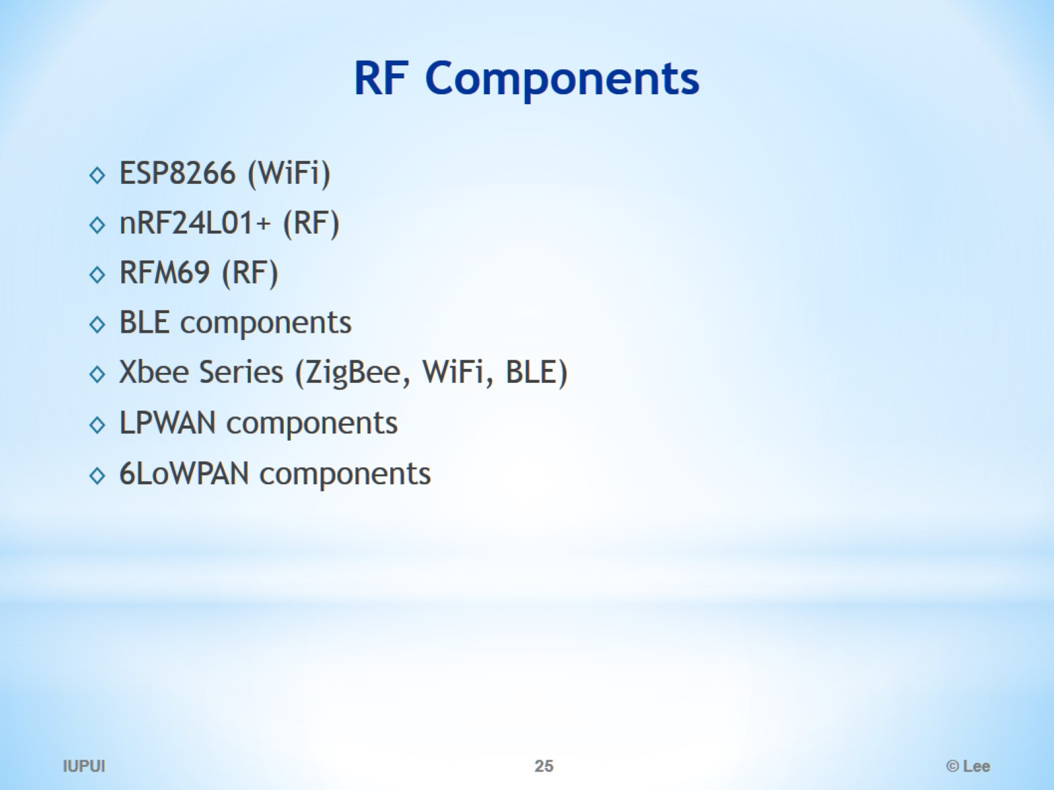
RF Components

Slide 26
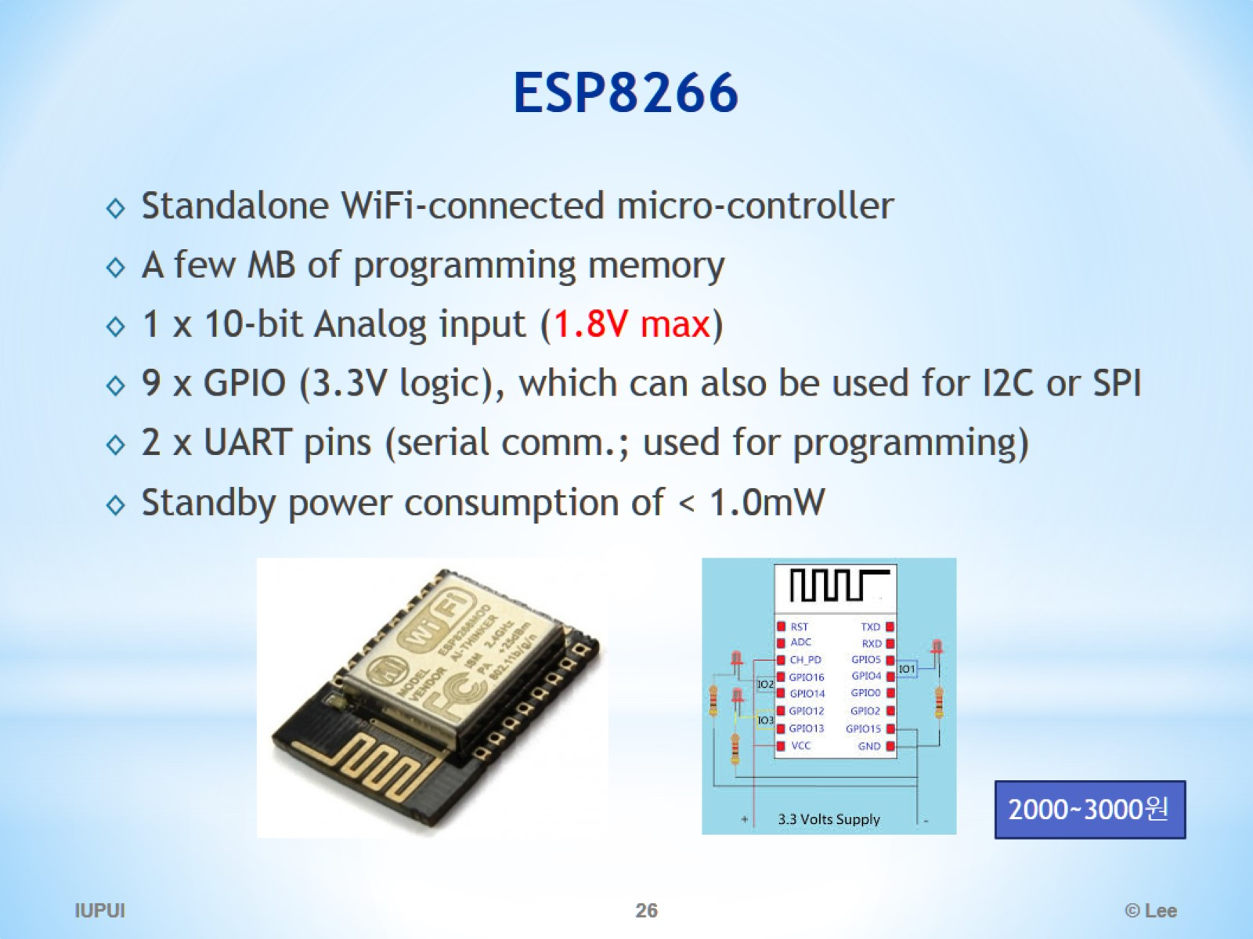
ESP8266

Slide 27
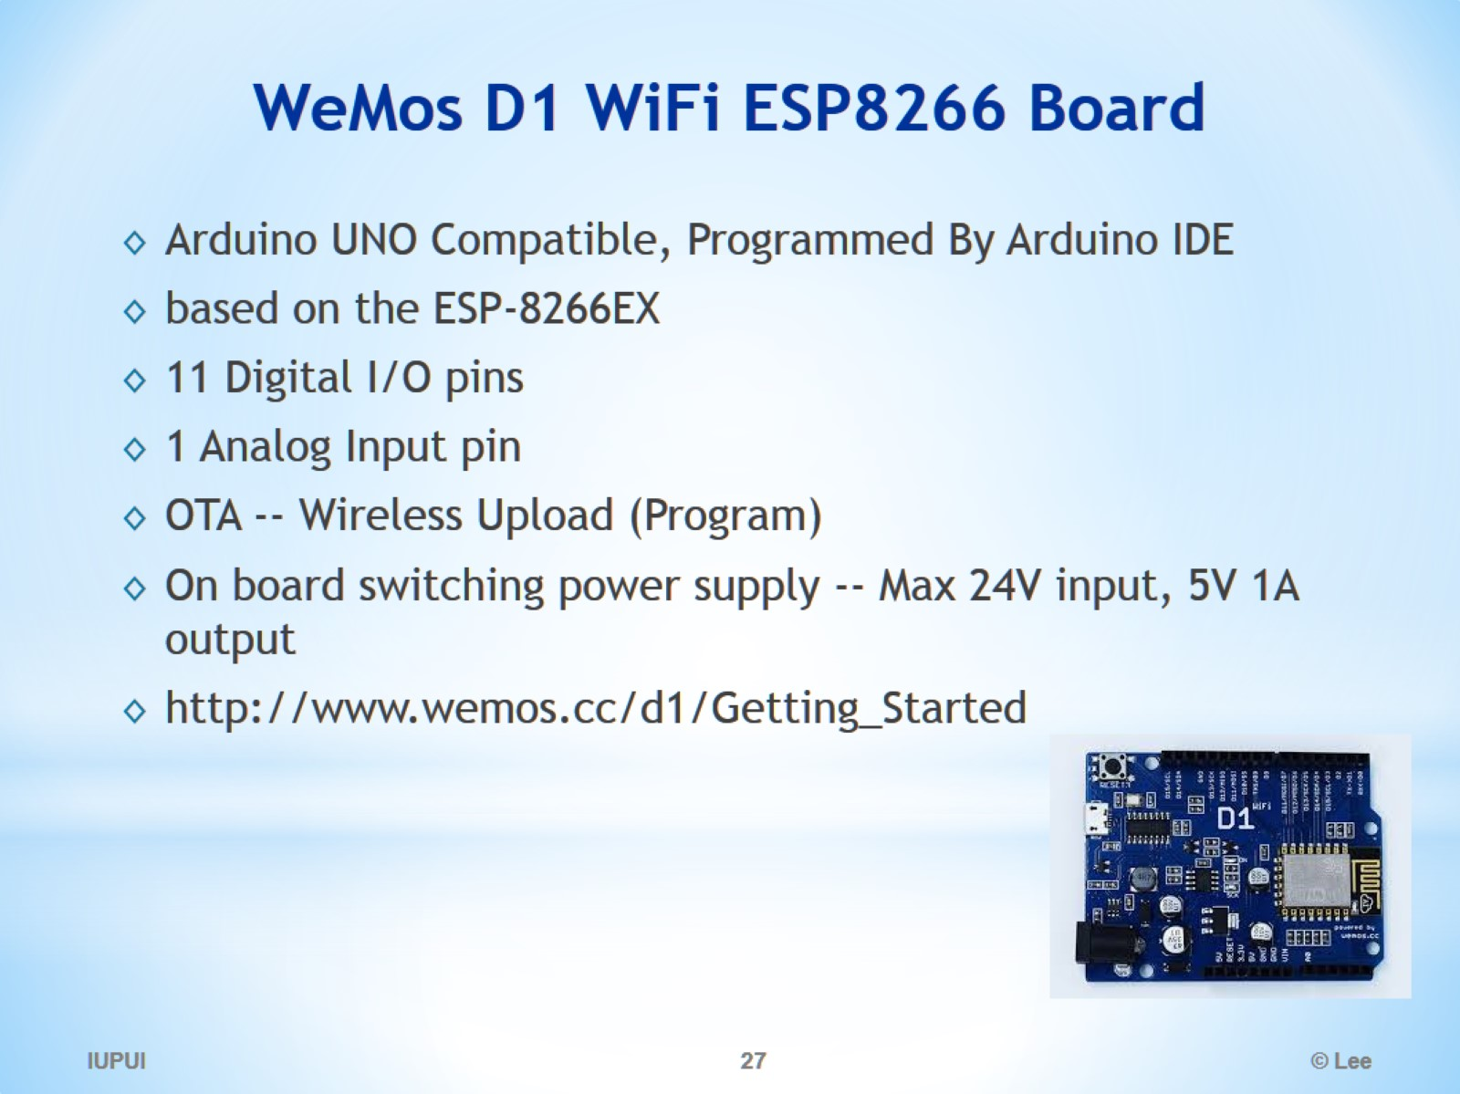
WeMos D1 WiFi ESP8266 Board

Slide 28

IoT Sensors, Actuators, and Controllers

Slide 29
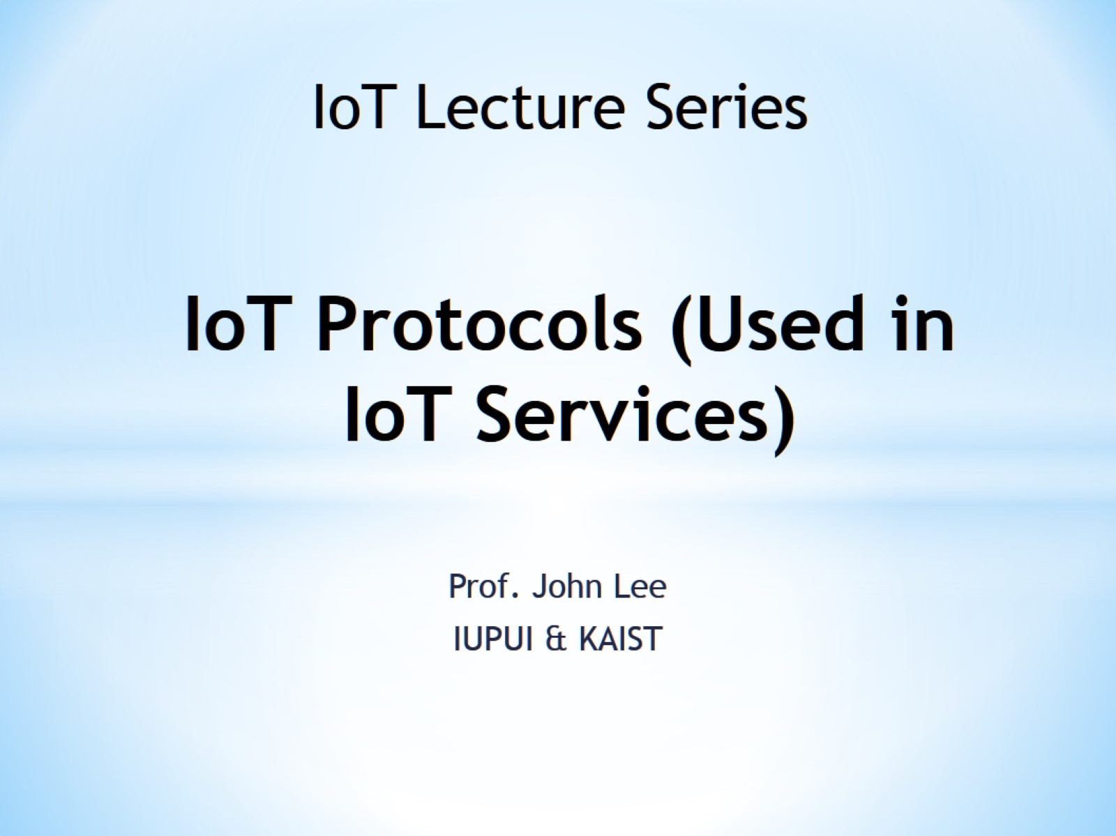
IoT Protocols (Used in IoT Services)

Slide 30
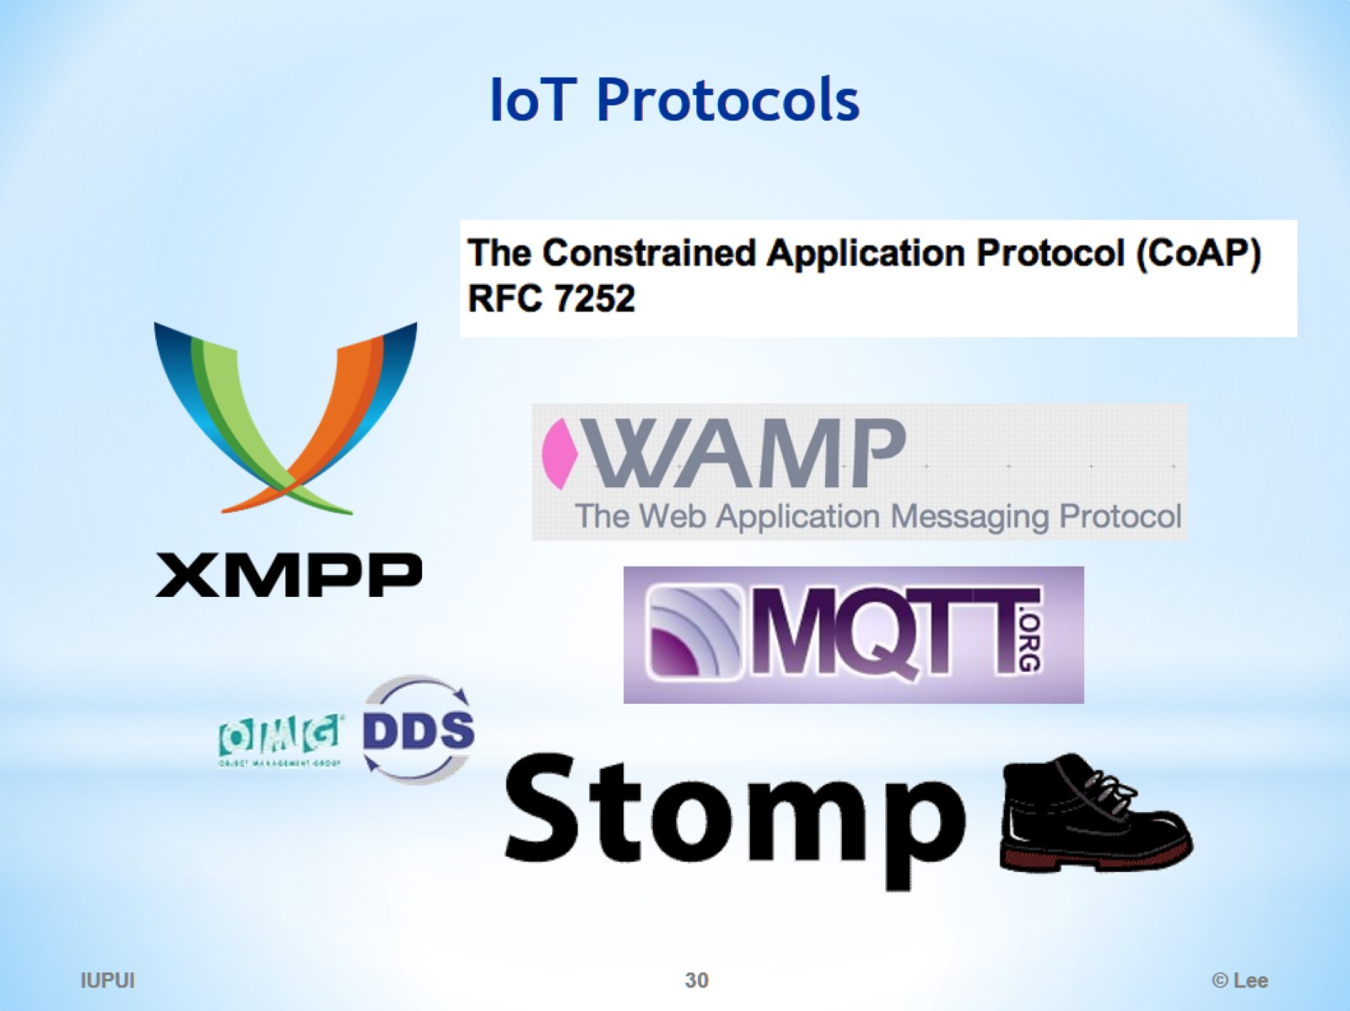
IoT Protocols

Slide 31
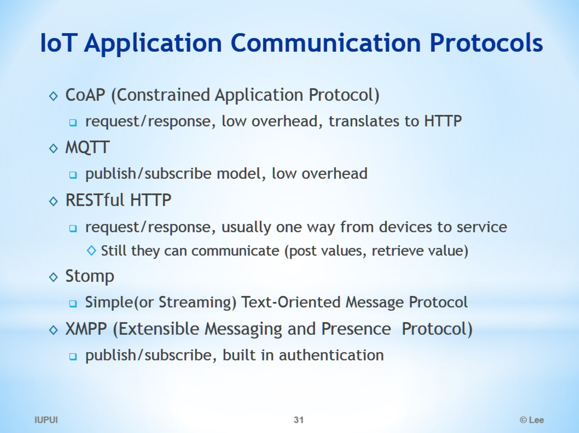
IoT Application Communication Protocols

Slide 32
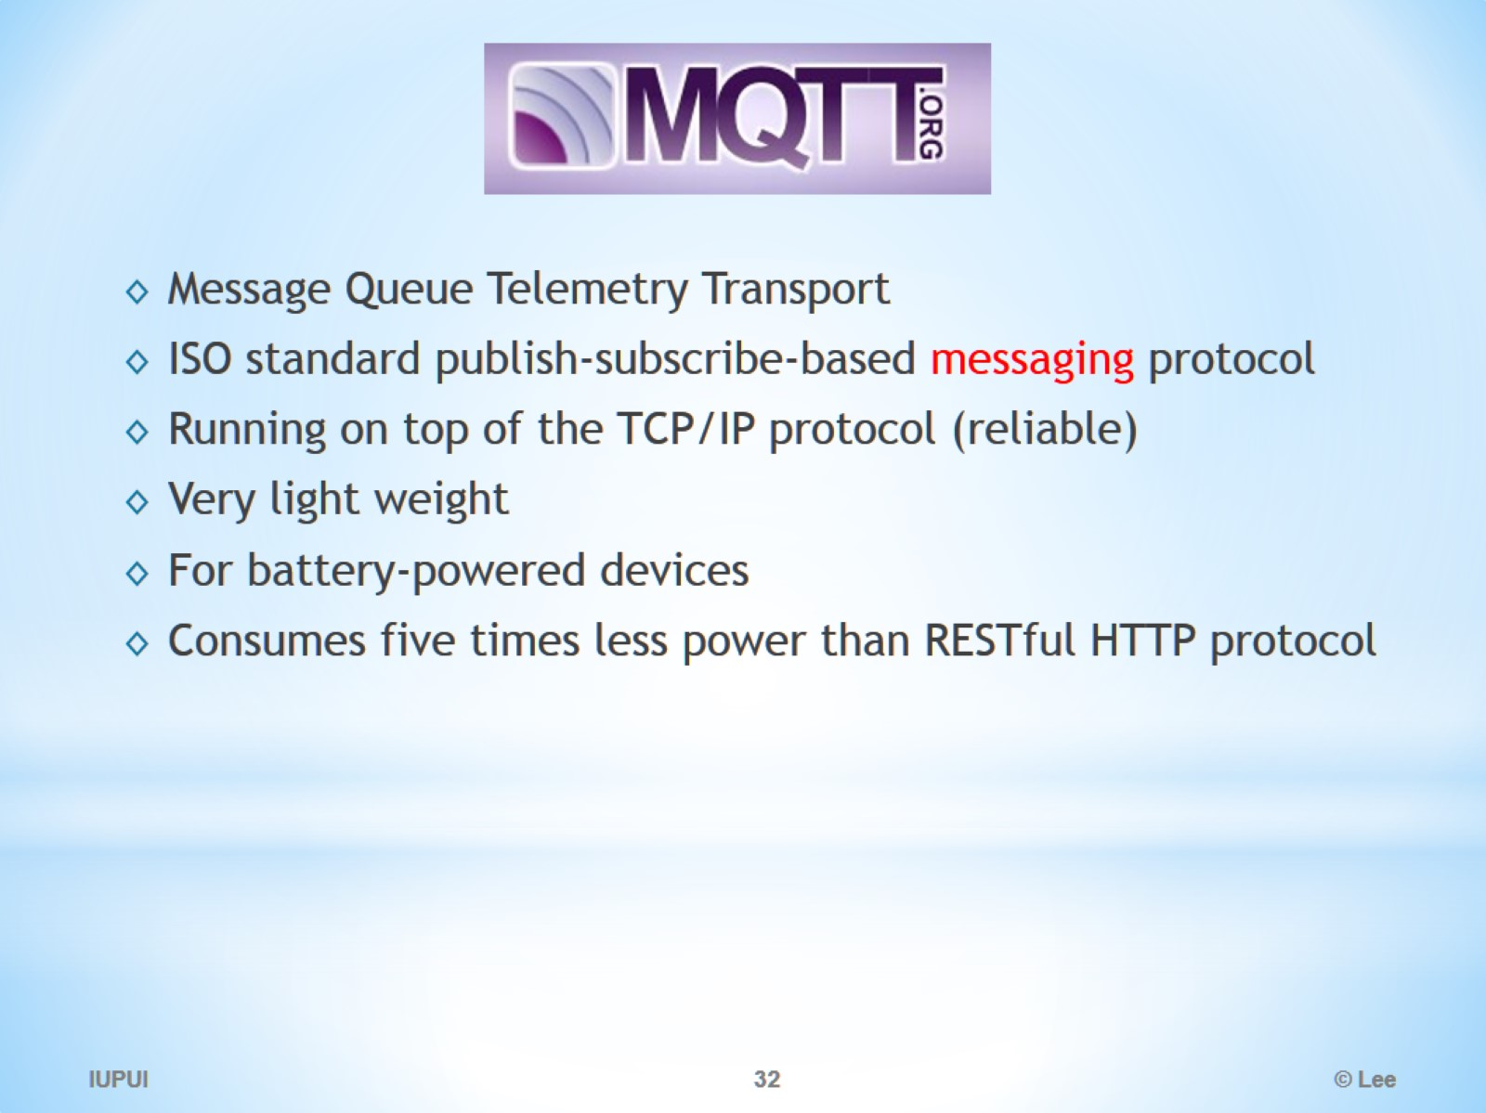
MQTT

Slide 33
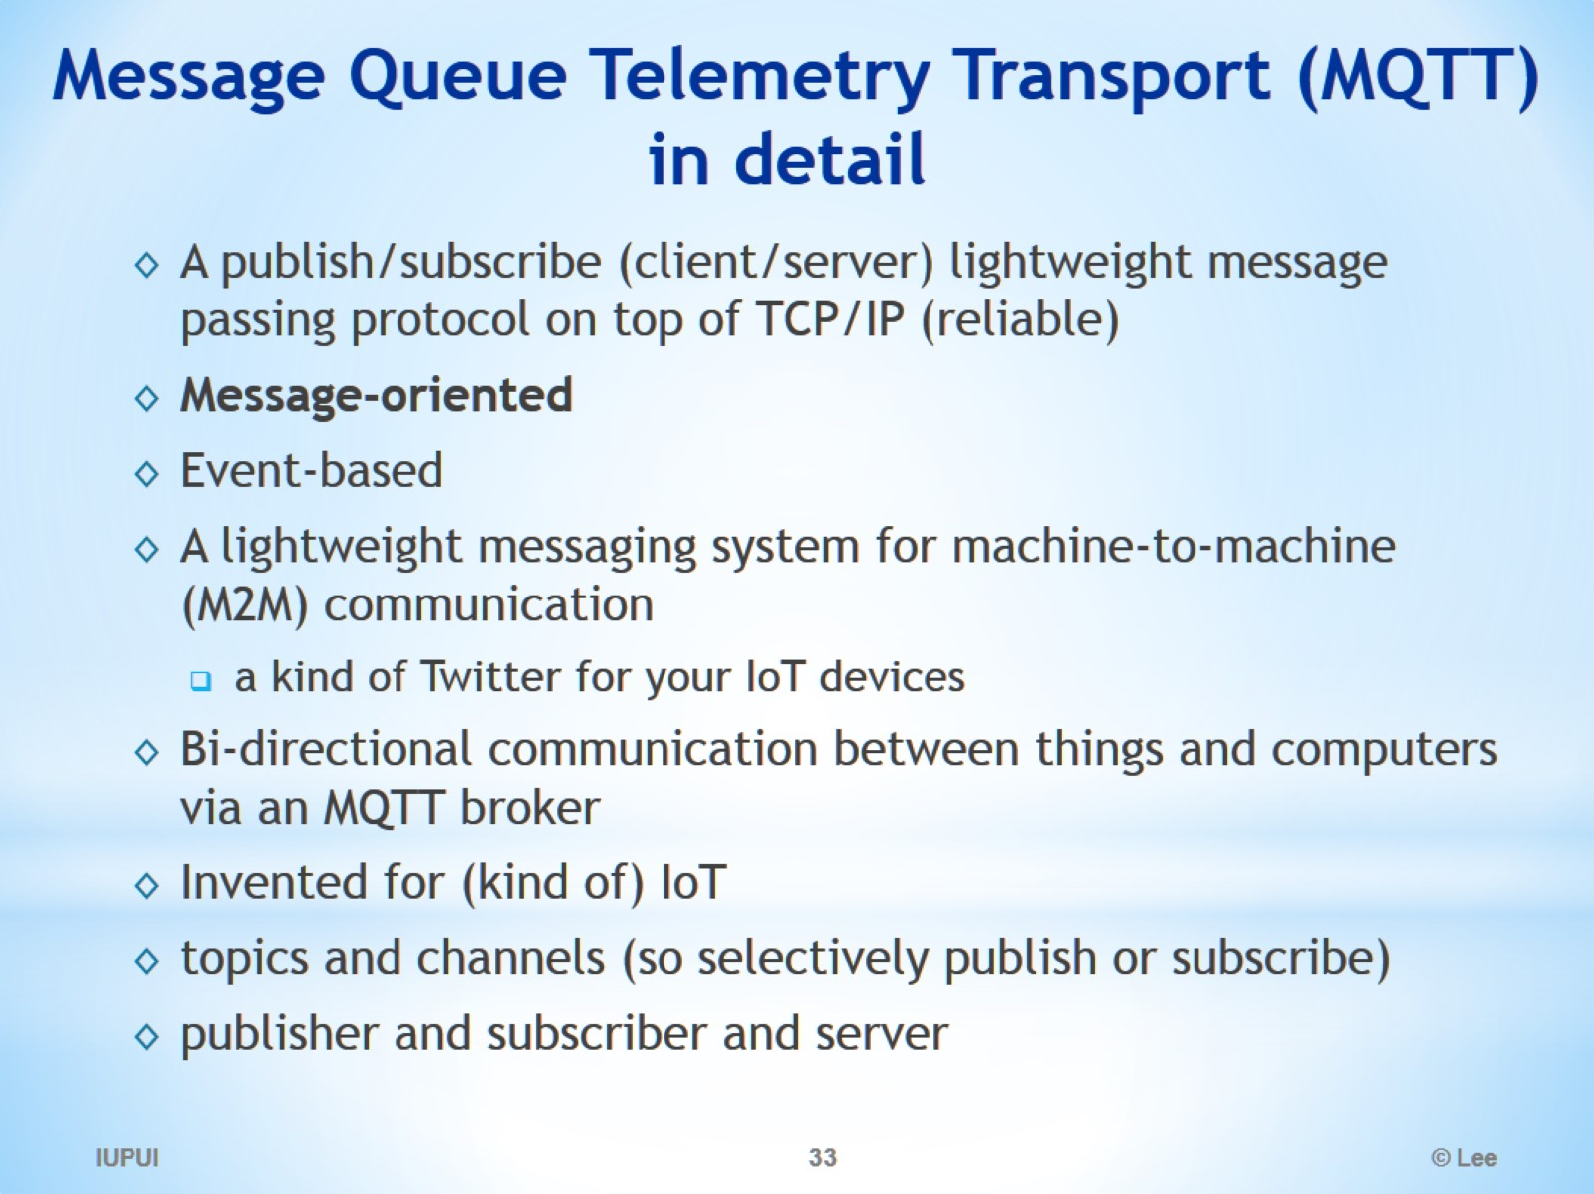
Message Queue Telemetry Transport (MQTT) in detail

Slide 34
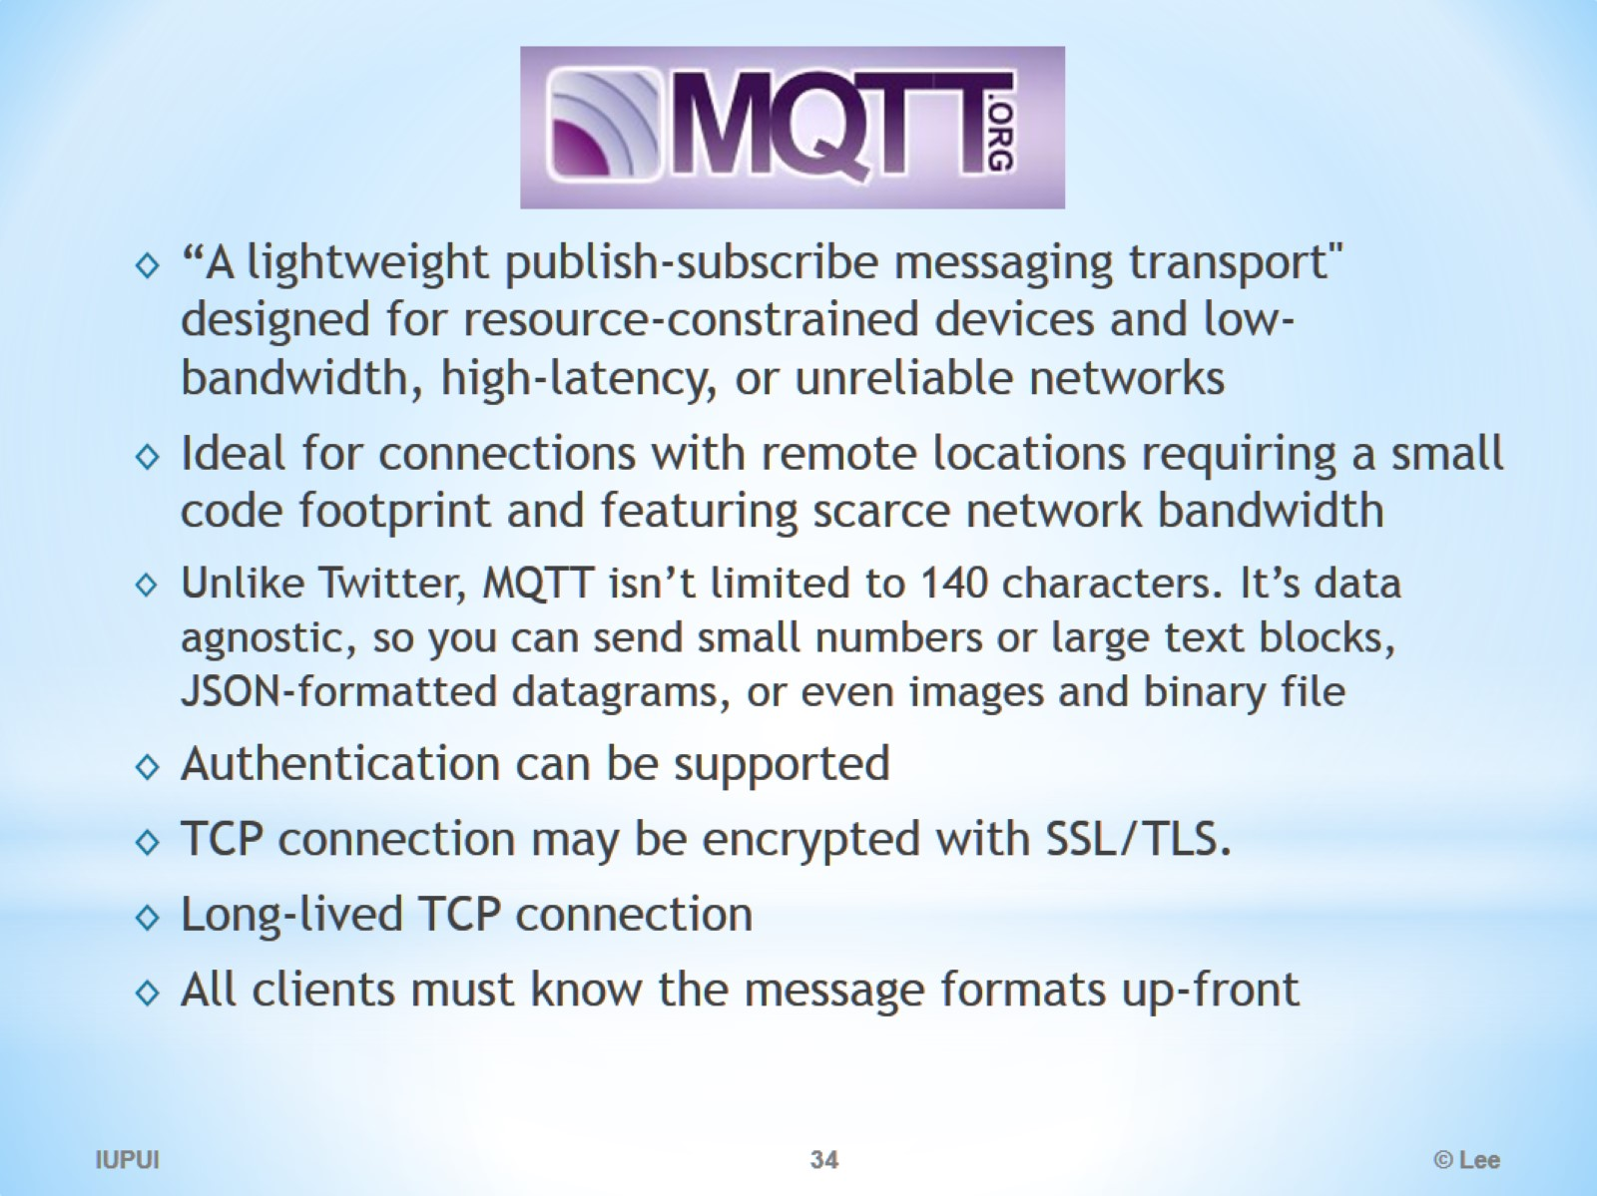
MQTT

Slide 35
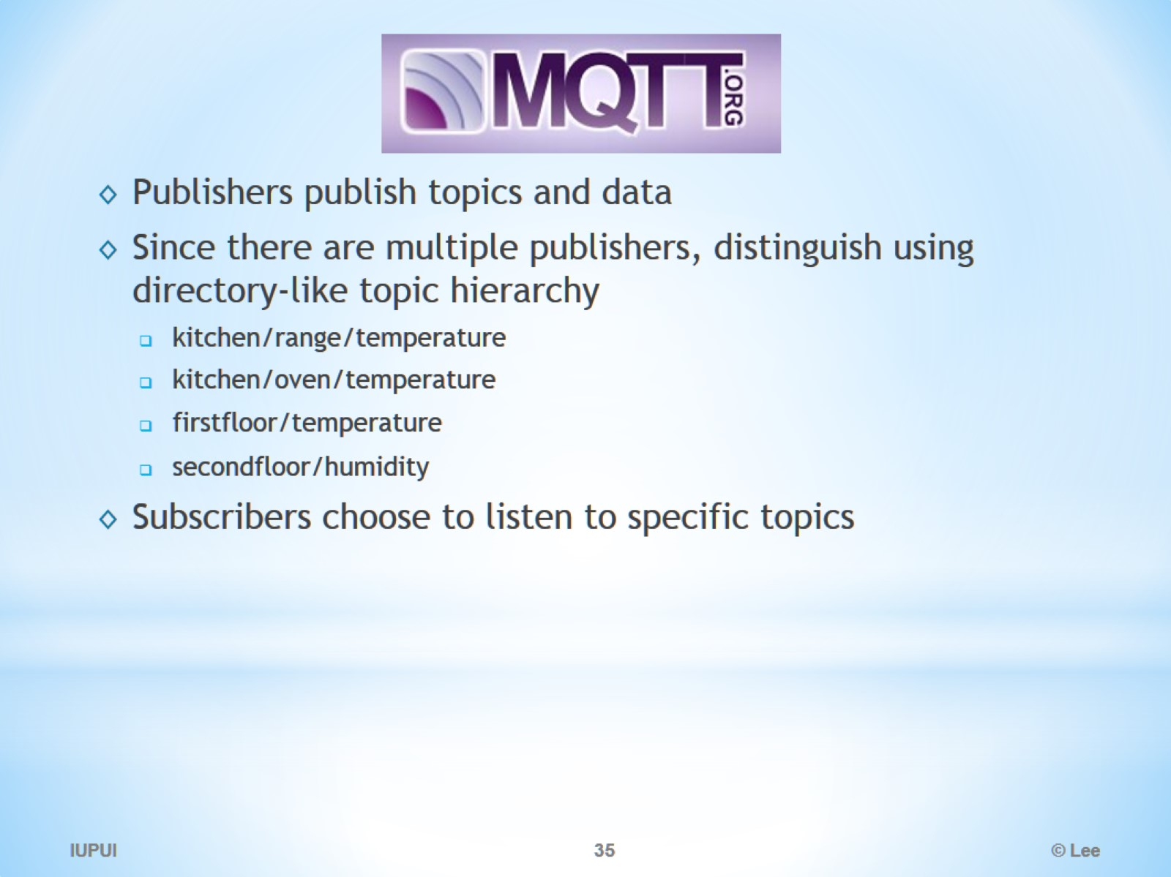

Slide 36
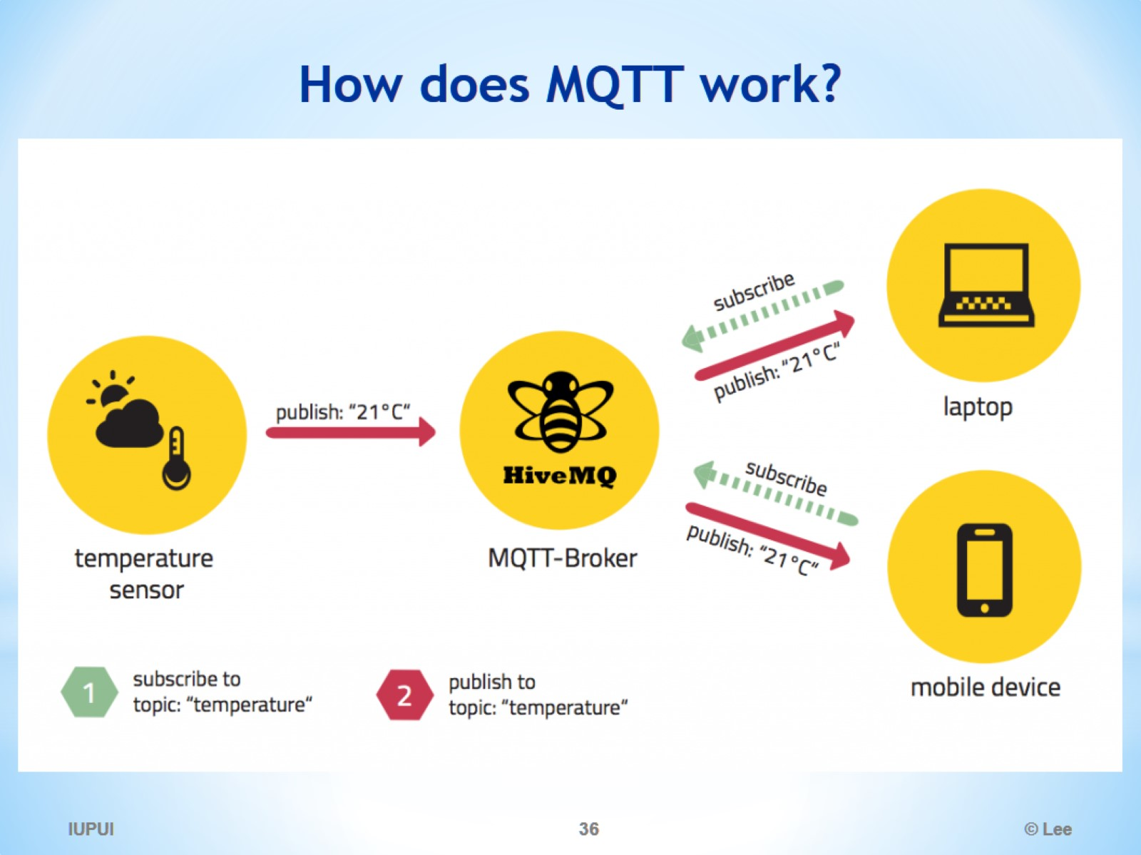
How does MQTT work?

Slide 37
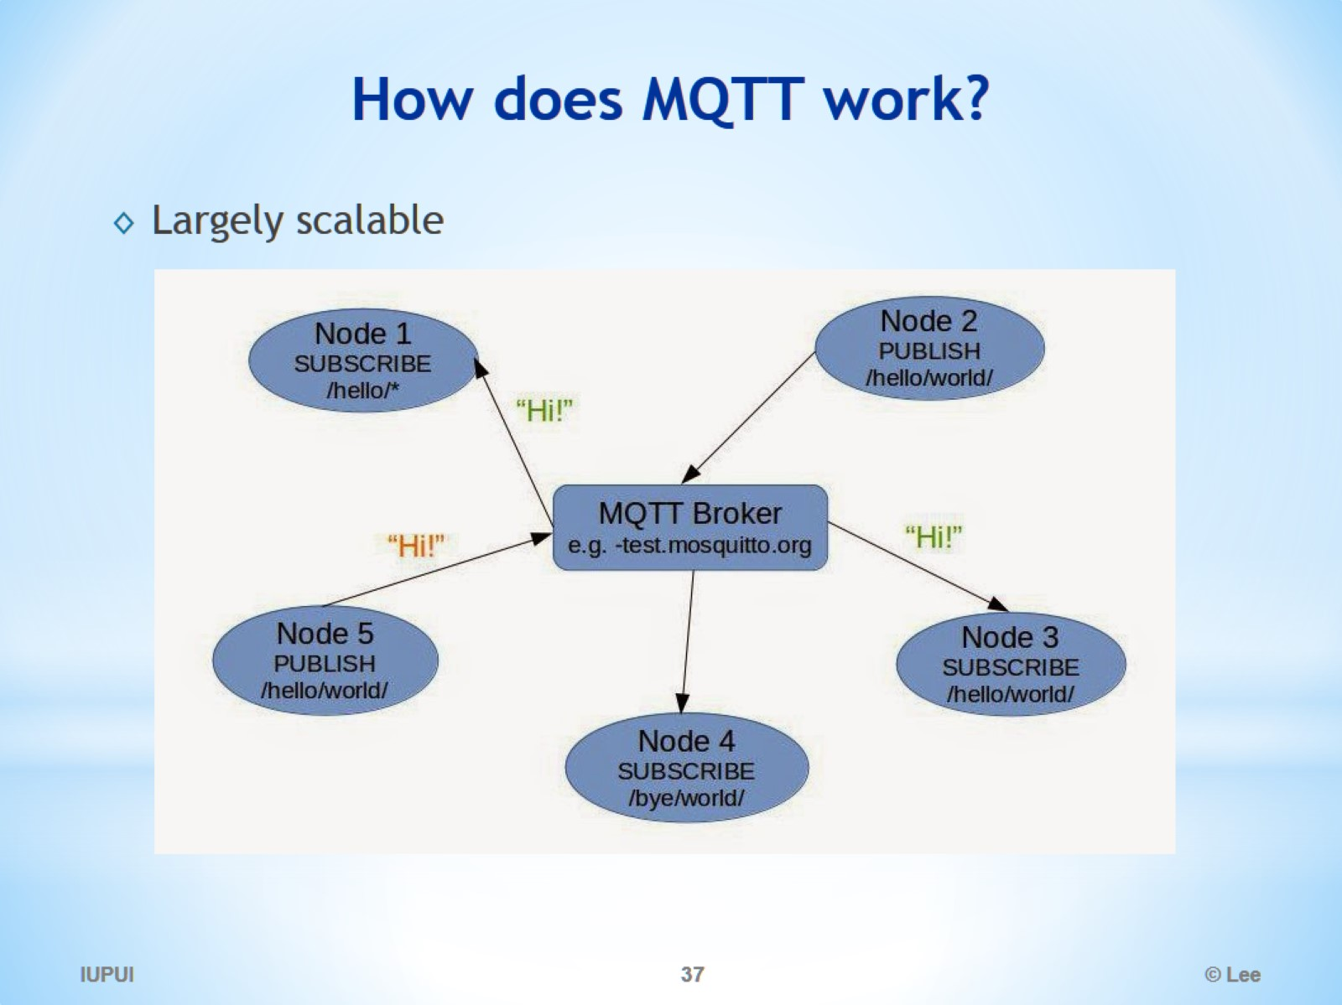
How does MQTT work?

Slide 38
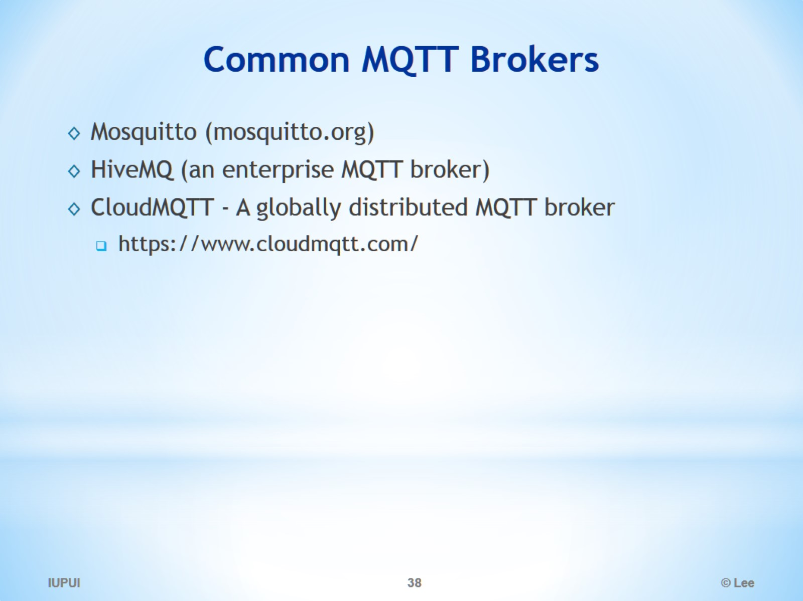
Common MQTT Brokers

